Slide 1


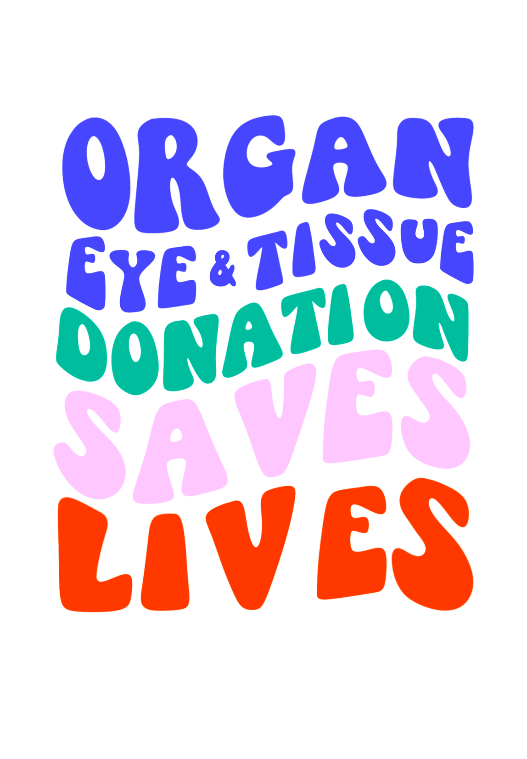

Notes:
Introduce yourself!
Who are you? What’s your job? Why are you here?
If your job is related to donation/transplantation, how did you choose your job?
If you are a volunteer, what motivates you to educate people about donation? (don’t tell your whole story yet)
As I go through my presentation, raise your hand if you have a question! I’ll do my best to answer (but I am not a health professional).
Today we will be talking about the importance of organ, eye, and tissue donation, how the process works, and the impact it can have.
Who here is thinking about getting their permit and/driver's license/ID card when they turn 15/16? Anyone already have their permit or license? Ask for a show of hands.
You will be asked if you want to be on organ donor at the DMV.
It is important get all the facts and be able to ask any questions you have on this topic so you can make an informed decision on whether you want to become a registered donor or not.
We are not here to register you as an organ donor. That is your choice to make and share with your family.

Slide 2
Content Warning
Sensitive Topics (death, medical procedures and images)
May Prompt:
Grief
Memories of medical trauma/
mistrust
Fear
Disgust
Any Emotion!
We Encourage:
Care for self/others
Respect of feelings and opinions
Reach out for support
Notes:
Content Warning:
Will be discussing sensitive topics like death, medical procedures, and showing some medical images.
Refer to slide: This presentation may prompt grief, memories of medical trauma/mistrust, fear, disgust, any emotion!
· All emotions are valid!
· 2 things can be true at once: you can feel uneasy AND inspired/impacted at the same time.
We encourage:
· Caring for yourself and others (be mindful of your classmates, you never know who in this room has been personally touched by organ donation/transplantation).
Respecting the feelings and opinions of others
Reaching out for support (teacher, counselor, parents, etc.)

Slide 3




Eye Bank
Outreach & Education
Organ Procurement
Tissue Bank
Notes:
There are 4 organizations involved in organ, eye, and tissue donation in Oregon and SW Washington.
· Donate Life Northwest - community outreach & education
· Vision Gift - eye bank for Oregon and SW Washington
· Solvita - tissue bank and facilitates tissue donation nationwide
Cascade Life Alliance (CLA) - Oregon's federally designated Organ Procurement Organization (OPO). They are the ones who go into the hospital to recover the organs for transplant!
This presentation is made in collaboration with all four organizations.

Slide 4




Kidney and liver
Transplants
Kidney Transplants
Heart Transplants
Kidney, liver, and heart
Transplants
Notes:
These are the 4 transplant hospitals that serve Oregon and SW Washington. All are located in Portland.
Legacy Health does kidney transplants
Providence does heart transplants
OHSU does kidney, liver, and heart transplants
The VA does kidney and liver transplant for veterans.
There is not a lung transplant program in Oregon. People in Oregon needing a lung transplant need to seek care in Seattle or in California.
Since these transplant hospitals are all located in Portland it creates a geographical inequity

Slide 5

Think about people saving lives…
Who comes to mind?
Notes:
Think about people saving lives. Who comes to mind?
Students raise hands or shout out answers or students share with partner or table group, and then share out loud.

Slide 6
Some Ideas:
Nurses
Researchers
Paramedics
Firefighters
Scientists
Lifeguards
And More!
Notes:
Review possible answers on this slide and acknowledge student contributions..
People that may not come to mind as often are organ, eye, and tissue donors.

Slide 7

Why should you care?
Notes:
Organ, eye and tissue donors saves lives!
Why should YOU care?
YOU have the power to educate yourselves and others and potentially save lives!

Slide 8

Questions or connections?
Notes:
Any questions before we get started? Any connections to donation that anyone would like to share?

Slide 9
What is organ, eye, and tissue donation?
Notes:
So, what is organ, eye, and tissue donation?
Take a few answers from students before revealing answer.

Slide 10
What is organ, eye, and tissue donation?
The opportunity to donate organs, corneas, and tissue after death to save or heal the lives of others.
1 organ donor can save up to 8 lives
1 eye/tissue donor can save or heal up to 125 lives
Notes:
Organ, eye, and tissue donation is the opportunity to donate organs, eyes, and tissues after death to save or heal the lives of people who need them.
1 organ donor can save up to 8 lives.
1 eye/tissue donor can save or heal up to 125 lives.
These numbers are pretty different, and we will discuss later why that is.

Slide 11
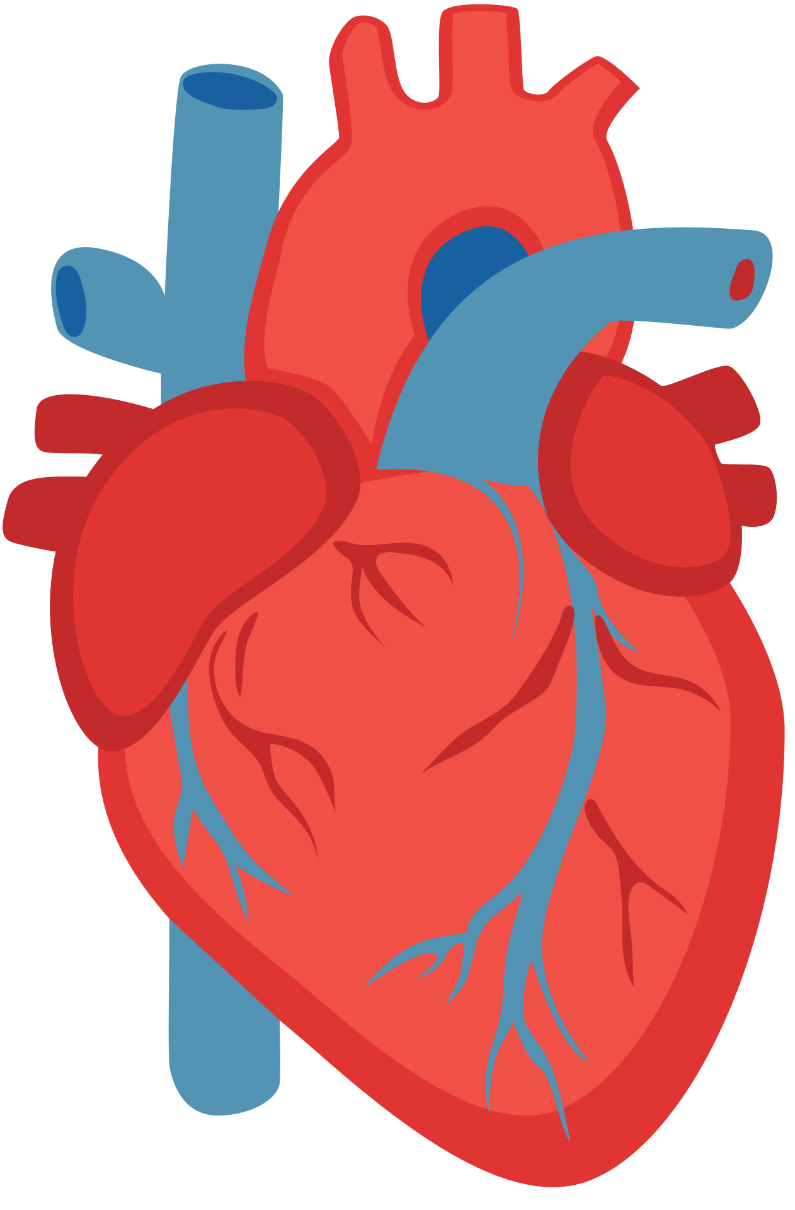
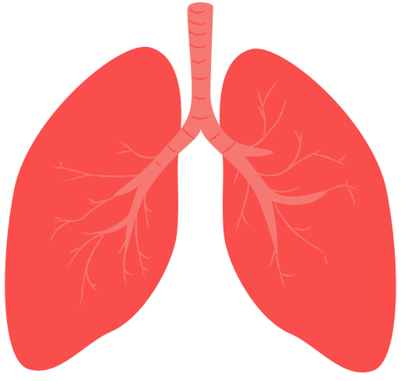
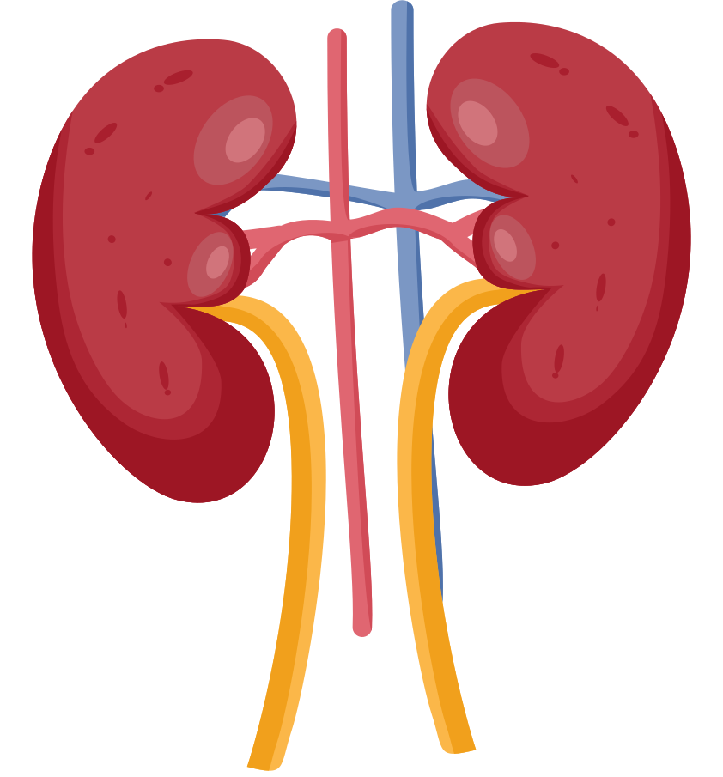
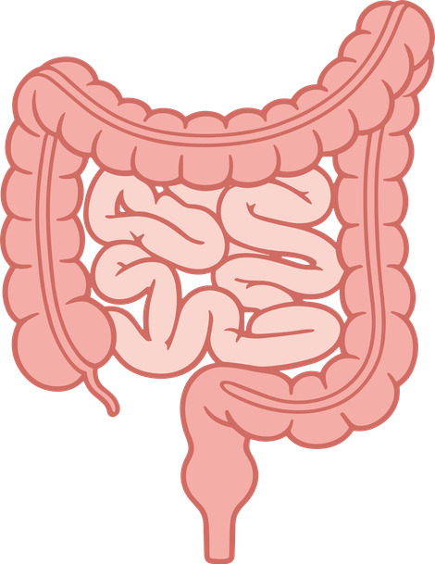
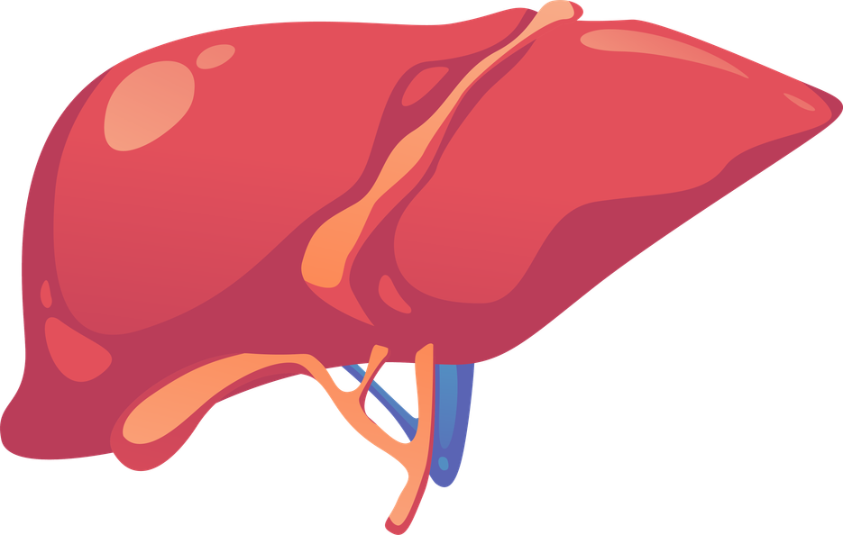

How does one organ donor save up to 8 lives?
There are 6 recoverable organs for transplant.
Can you guess them?
2 Lungs
2 Kidneys
Pancreas
Heart
Liver
Intestine
Notes:
How does one organ donor save up to 8 lives?
*click*
There are 6 recoverable organs for transplant. Can you guess them?
· Students raise hands or shout out guesses. Can also quickly brainstorm in pairs or groups before sharing.
Click to show all the organ images.
· Reveal answers one by one on each *click*
· Heart, 2 lungs- can go to different people, liver, 2 kidneys – can go to different people, (small) intestines, pancreas
· Mention: because lungs and kidneys can potentially be split up, that is how you get the 8 lives saved!
Ask does anyone know which organ is in the most need? (take student gusses)
**The kidney in highest demand. About 86 % of people on the waitlist are waiting for a kidney**

Slide 12

Let’s Get Started!
Organ Donation:
It all begins with someone needing an organ transplant...
Notes:
Ok, but why do we need organ donation in the first place?
It all begins with someone needing an organ transplant – or else there would be no need for people to donate.

Slide 13
Organ Failure
Organ failure occurs when one or more of a person’s organs stop working properly.
Notes:
When someone needs an organ transplant, it means they are in organ failure.
What is organ failure?
Organ failure is when one or more of a person’s organs stop working properly.
This can be due to sudden causes like sepsis and infections, severe trauma, loss of blood or oxygen, or toxic poisoning such as a drug overdose. Organ failure can also happen due to chronic conditions like high blood pressure, diabetes, liver disease, or autoimmune conditions where the immune system attacks health tissue.
There are some simple things you can do today to help prevent or delay these conditions like high blood pressure and diabetes. They are:
Stay at a healthy weight for you (that is different for everyone).
Exercise, be conscious of how you move your body and how often.
Do the best you can to make healthy eating choices about the food you eat.
The better you treat your body now, the better it will treat you later.

Slide 14




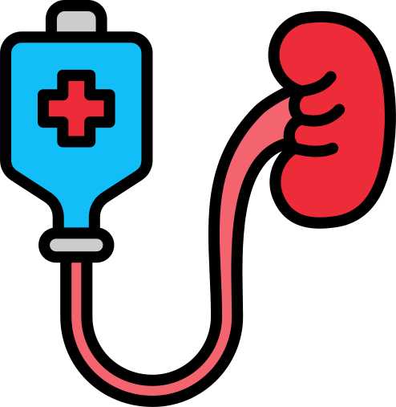

Organ Failure
People may be...
Very sick
Experiencing intense fatigue
On a strict diet
Housebound or bedbound
On dialysis
Needing a transplant to survive
Notes:
People who are in organ failure are very sick. They could be:
· Experiencing intense fatigue
· On a strict diet
· On dialysis if they are in kidney failure, meaning they need treatment multiple times a week or even daily for several hours at a time, while a dialysis machine filters their blood.
· Sometimes they may not be able to leave their house or get out of bed or may need to be on oxygen.
· Need a transplant for survival.
If they remain untreated and don’t receive a transplant, they will die. This is extremely serious.

Slide 15
Organ Failure
National Transplant Waitlist
(UNOS)
Notes:
People experiencing organ failure are trying to join the National Transplant Waitlist. This waitlist is managed by UNOS.
Being listed on the waitlist is not automatic if you are in organ failure. There are many health screenings and physical, social, emotional, and financial assessments done by transplant hospitals to make sure someone is a good candidate for transplant.

Slide 16
National Transplant Waitlist
(UNOS)
UNOS = United Network for Organ Sharing
Match transplant candidates with organ donors based on a number of factors....
Notes:
UNOS stands for United Network for Organ Sharing.
They match transplant candidates with organ donors based on a number of factors.

Slide 17


National Transplant Waitlist
Matching Donors and Recipients
Factors Considered:
  Blood type
  Body size
  How sick the patient is
  Tissue type
  Length of time on waitlist
  How close they are to the donor (location)
NOT Considered:
  Race/ethnicity
  Gender identity
  Income
  Celebrity
  Social status
Notes:
Read off list
Factors Considered:
1. Blood type
2. Body size (ex: a baby cannot donate to a full-grown adult)
3. How sick the patient is
4. Tissue type
5. Length of time on waitlist
6. How close they are to the donor/transplant hospital (location/proximity wise)
Factors that are NEVER considered, despite what the media says:
· Race/ethnicity
· Gender identity
· Income
· Celebrity status
Social status

Slide 18

Do you know Selena Gomez?
Selena received a kidney transplant in 2017
  Media focused on her quick kidney transplant
  Perception that she "jumped" the waitlist
  Reality: it was a direct donation from a living kidney donor
Notes:
Anyone here heard of Selena Gomez? Selena (famous actress, singer, and has a makeup line.) received a kidney transplant in 2017.
· Media focused on her quick kidney transplant, emphasizing she received one almost immediately, how did that happen?
· Perception that she "jumped" the waitlist due to her celebrity status or that she paid to receive a transplant quicker.
· Reality: it was a direct donation from a living kidney donor. Her friend met the criteria to become a living donor (donating while you are still alive) and was a great match for Selena. She opted to undergo the surgery and gift her kidney to Selena.

Slide 19
Zooming Out!
Big Picture: How many people does this affect?
Notes:
We’ve just described how needing a transplant affects an individual. Now let's zoom out and talk about how many individuals this affects in the United States.
For the most current national and state data, visit
https://hrsa.unos.org/data/view-data-reports/national-data/
https://hrsa.unos.org/data/view-data-reports/state-data/.

Slide 20
Lives Affected
  People currently on waitlist:
Notes:
People currently on the waitlist… [next slide]

Slide 21
Lives Affected
  People currently on waitlist:
109,000+
Notes:
Add website links Nationally, there are well over 100,000+ (109,000 and rising as of 2026) people waiting for a lifesaving organ transplant!!!
August 13, 2026 OPTN numbers: Nationally,109,815 candidates are on the waitlist. In Oregon,1,346 candidates are on the waitlist. In Washington there are 1,643 candidates.

Slide 22

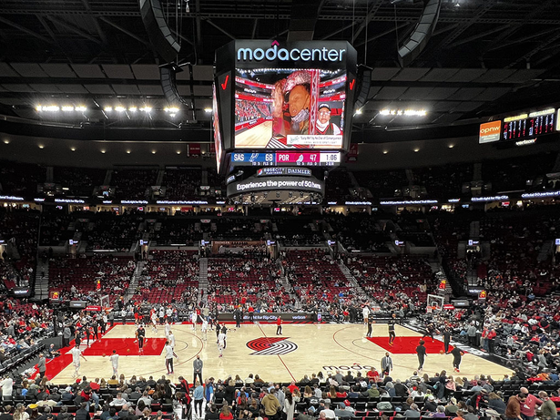


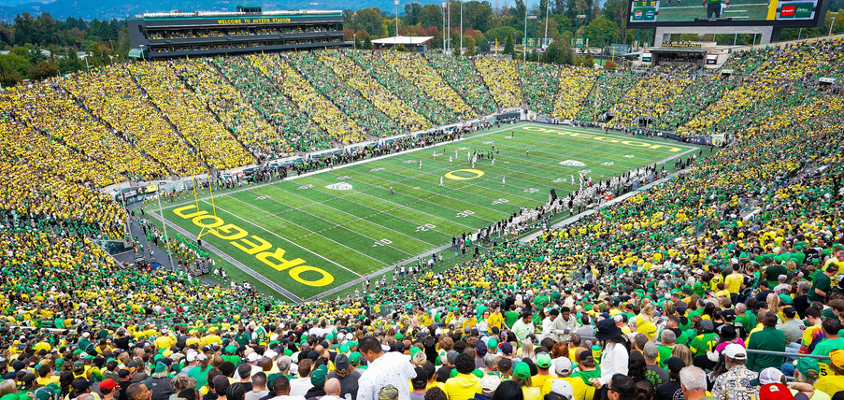
109,000+
Moda Center
Has anybody been to:
Reser Stadium
Autzen Stadium
Notes:
Who has ever been to the MODA Center for a basketball game or concert or Reser or Autzen stadium for a football game? (Show of hands)
If you have been to any games or events at any of the locations, or you’ve seen them on TV, you know how large they are. The capacity of all three stadiums combined is about 100,000 people.
Over 100,000 is a huge number and is still less than the people waiting for a life-saving transplant.

Slide 23
Lives Affected
  People currently on waitlist:
  People dying each day waiting:
109,000+
Notes:
Unfortunately, some of those individuals on the waitlist don’t receive a transplant in time, so, people dying each day while waiting for a transplant…[next slide]

Slide 24
Lives Affected
  People currently on waitlist:
  People dying each day while waiting:
109,000+
13
Notes:
On average 13 people die every day in the US while waiting.

Slide 25

13 people per day
die in the US because they run out of time waiting for a transplant.
Notes:
Because of these statistics, it’s important for us to get the message out there.

Slide 26
Lives Affected
  People currently on waitlist:
  People dying each day waiting:
  A new person is added to the waitlist:
109,000+
13 per day
Notes:
A new person is added to the waitlist…[next slide]

Slide 27
Lives Affected
  People currently on waitlist:
  People dying each day waiting:
  A new person is added to the waitlist:
109,000+
13 per day
Every 8 minutes
Notes:
Every 8 minutes.

Slide 28

Every 8 minutes
How many will be added during this class period? How many by the end of the day today?
Notes:
· Think about how long we are together for this presentation. How many will be added during this class period? How many by the end of the day today?
· (45 min = 5 people added, 90 min = 11 people added, one day = 180 people)

Slide 29

This affects so many people, and you have the power to help!
Notes:
This affects so many people, not only the ones who need a transplant (their family, friends, and community too).
YOU are important; you have the power to improve these numbers by sharing the facts you learn today with your friends and family, and by registering to be a donor if you feel compelled.

Slide 30
How Someone Becomes a Donor
Notes:
Let’s discuss the process of how someone becomes an organ donor.
· Share a video created by UNOS that concisely describes the organ donation process and makes it easy to understand.

Slide 31

Notes:
*Click on the play button in video with your cursor, DO NOT USE KEYBOARD! This video is 2 minutes and 33 seconds.
*If video is not working in slideshow, go to pre-loaded video in different tab.
https://www.youtube.com/watch?v=gOGDlasUm0Q
*Enable closed captions, and ensure Quality is set to 1080p HD when clicking on the cog icon.

Slide 32
Transplant is not a cure.
It is a treatment.
Notes:
It’s important to know, when a person receives a transplant it is considered a treatment not a cure to the disease that is affecting their organ.
Along with this treatment organ recipients face a lifelong need to take immunosuppressant drugs or anti-rejections medication, have continued medical visits to make sure the recipient and their organ is healthy, and have a dedication to a healthy lifestyle.
The trade off is more life. More time with family and friends, more time to to achieve goals and dreams.

Slide 33
Name that Organ
The following slides contain graphic medical images of organs you do not have to look!
Notes:
These slides are hidden/skipped, if you want use them and/or have time to use them, unhide (Powerpoint) or unskip (Google Slides), by right clicking the individual slides in the column on the left side of the screen and choosing unhide or unskip.
Give a warning about graphic images within the next 4 slides.
It’s time for Name that Diseased Organ! Pause after first click for students to guess.

Slide 34
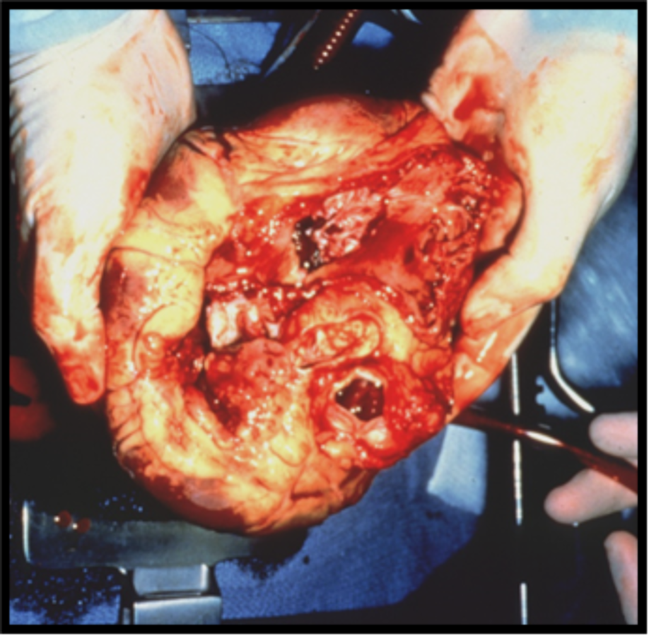
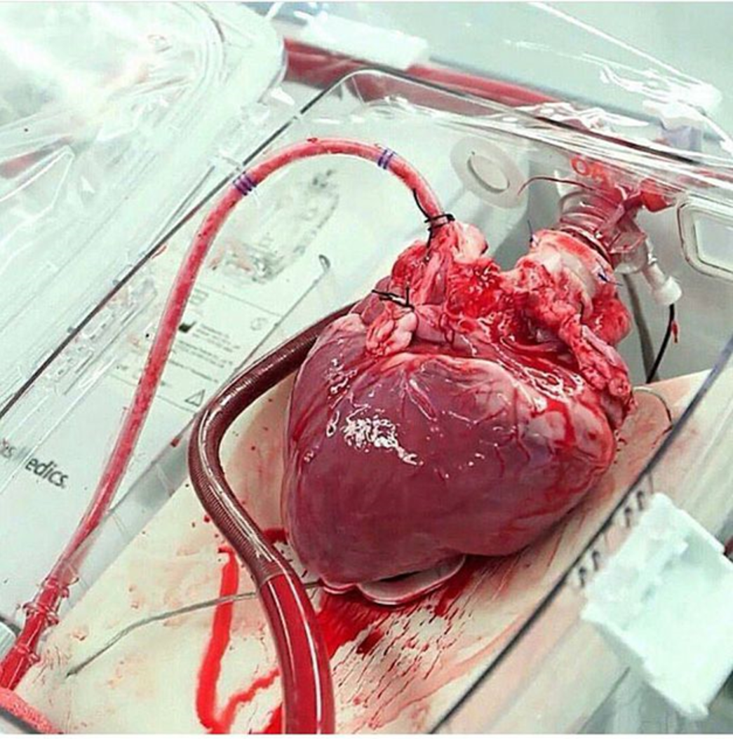
What organ is this?
Notes:
(Click) This first picture is of a diseased heart: Cardiomyopathy. Cardiomyopathy is a disease that can occur as a result of a virus, cancer treatments, hereditary causes, or unknown reasons. The heart grows larger and larger, and it becomes increasingly difficult for it to function adequately. People who suffer from cardiomyopathy can have shortness of breath, fatigue, swelling in legs, and irregular heartbeats. They can feel dizzy or lightheaded and faint or feel chest pain or pressure.
(Click) The picture on the right is of a healthy heart.

Slide 35
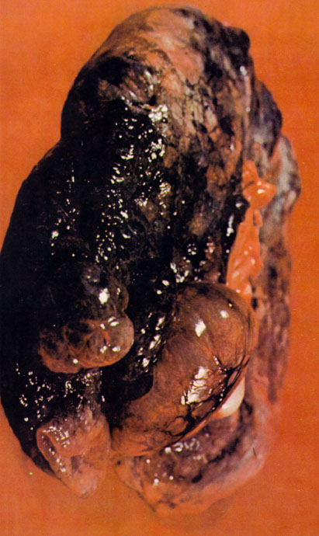
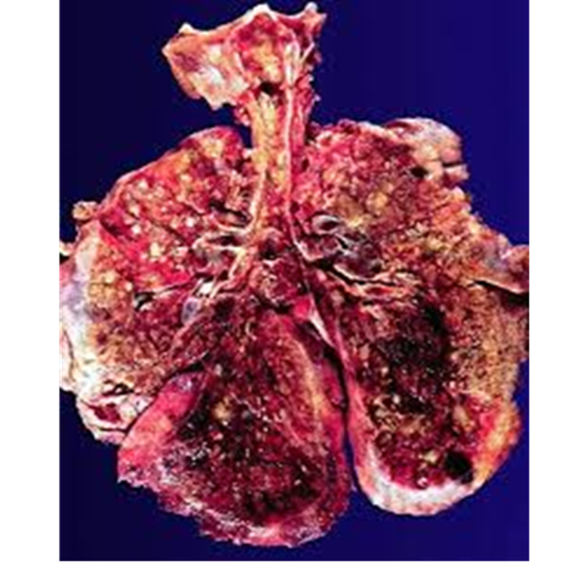
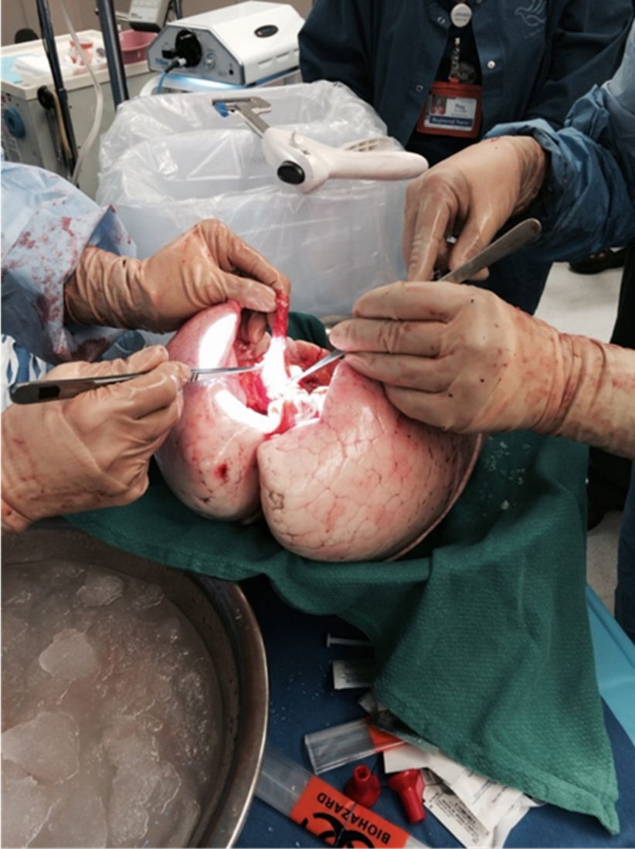
What organ is this?
Notes:
The first image is a lung with emphysema. The main cause is smoking, however there are also other diseases that may lead to emphysema. The second image is of a lung with cystic fibrosis. Cystic fibrosis in an inherited genetic disorder that causes the body to produce thick, sticky mucus.
When someone is in need of a lung transplant they are usually on oxygen 24 hrs/day and can’t walk more than a few feet without losing their breath. They also tend to have blue fingertips and toes because the oxygen needed to turn the blood red is in short supply and does not circulate properly.
The last image is of a healthy lung.

Slide 36
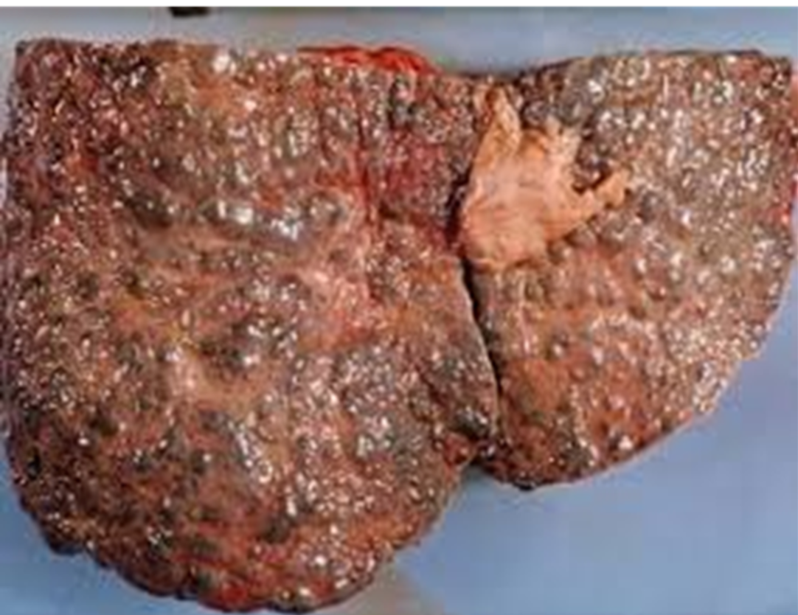
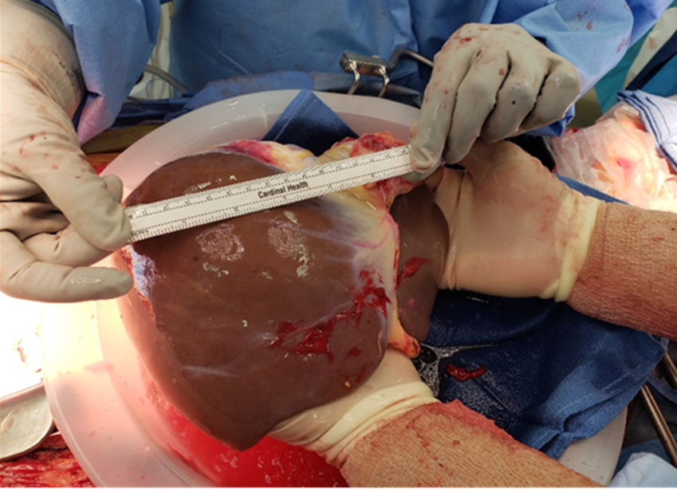
What organ is this?
Notes:
(Click) This is a diseased liver with cirrhosis. About 40% of those needed a liver transplant suffer from alcohol related cirrhosis. 20% of liver transplant patients suffer from Hepatitis C and another 20% suffer from MASH (formerly fatty liver disease”). **It is important to note that people who suffer from alcoholism must meet stringent requirements before they can ever be placed on the waiting list.**
(Click) On the right we have a healthy liver. The liver is like a chemical factory that destroys toxic substances in the blood such as drugs and alcohol. It also processes nutrients and breaks down proteins, fats, carbohydrates and stores energy for later use.
Optional: People who are in liver failure may experience an accumulation of fluids in the belly and the extremities, Jaundice (which causes a yellowing of the skin and whites of the eyes as well as itching), and mental disorientation or confusion.

Slide 37
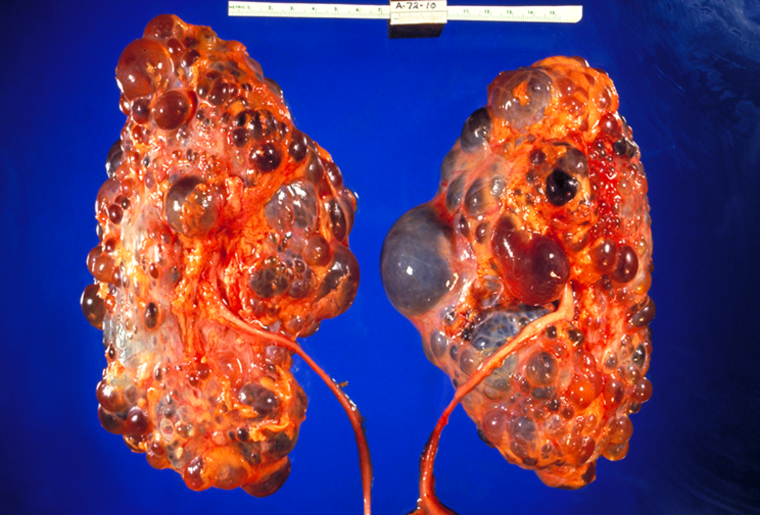
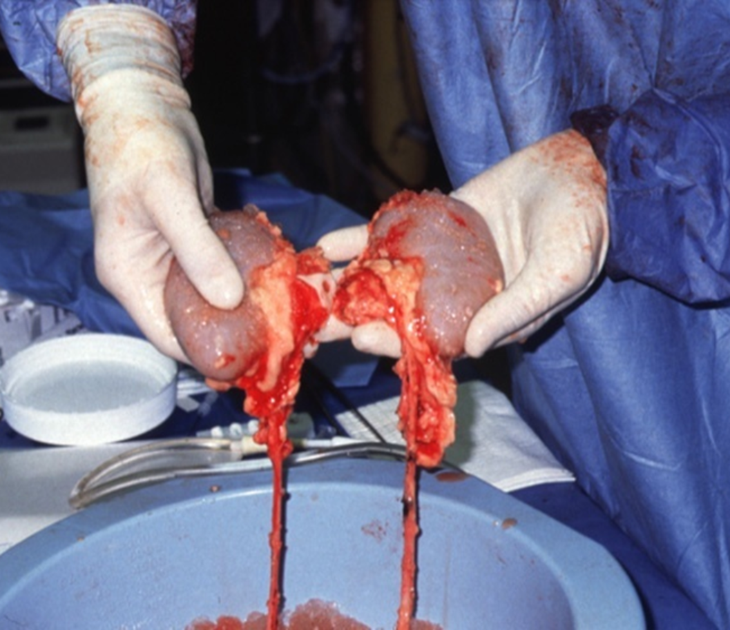
What organ is this?
Notes:
(Click) On the left we have two polycystic kidneys. This is an inherited condition that causes the kidneys to fail when many fluid filled sacs engorge the kidneys.
(Click) One the right we have a picture of healthy kidneys. The kidneys are responsible for filtering the blood. The kidneys are retrieved together and then separated for transplantation. Kidney donors can be the source of two transplants because humans only need one kidney to survive.
People suffering from kidney failure can experience swelling (edema) in their ankles, feet and hands due to the body holding excess fluid. They can feel fatigue, shortness of breath, and itchy skin due to the waste imbalances in the blood. They can experience muscle cramps, loss of appetite, nausea and vomiting, and experience changes in urination.

Slide 38
ANY QUESTIONS?
Notes:
Transition: any questions?

Slide 39
EYE & TISSUE DONATION/ TRANSPLANTATION
Notes:
Eye/tissue
· After organs are recovered from a deceased donor, corneas and tissue can oftentimes be recovered. Sometimes a person is not able to be an organ donor, but can be a cornea and tissue donor.
· This is the work of our partners VisionGift (eye) and Solvita (tissue).

Slide 40


ONE EYE/TISSUE DONOR CAN SAVE OR HEAL UP TO 125 LIVES!
Why more lives than organ donation?
Notes:
· Reminder: 1 organ donor can save up to 8 lives, 1 eye/tissue donor can save/enhance up to 125 lives!
· Why is it so much more?
[Optional] Have students brainstorm and share why they think so.

Slide 41


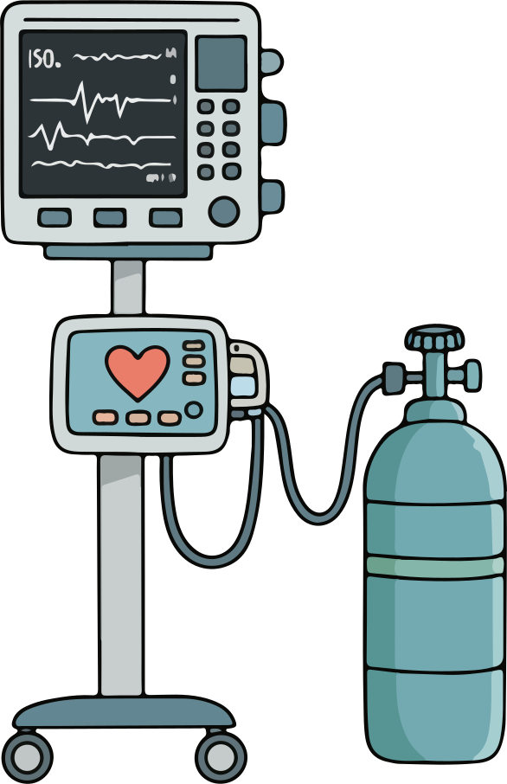


Organ Donation
Eye/Tissue Donation
Can pass away outside of a hospital
Must pass away in a hospital
Be connected to a ventilator
Does not need to be connected to a ventilator
Needs constant blood flow and oxygen
Stays viable longer w/o blood and oxygen & can be stored
Limited to 6 transplantable
organs
So much tissue possible to donate
Notes:
Differences between organ donation and eye/tissue donation
· Organ donation has very strict medical criteria that must be met in order for the process to work and organs to stay viable.
· Eye/tissue donation does not have such strict medical criteria.
· For example (refer to slide):
Organ donation → must pass away in the hospital.
Eye/tissue → can pass away outside of a hospital.
Organ donation → needs to be connected to a ventilator (breathing machine found in a hospital). This forces the patient to breathe because they no longer can on their own due to severe injury. Breathing supplies oxygen to the organs.
Eye/tissue → does not need to be connected to a ventilator.
Organ donation → needs constant blood flow and oxygen. Organs will no longer be viable (healthy and functional) for transplant if they go too long without blood and oxygen.
Eye/tissue → stays viable for much longer without blood and oxygen.
Organ donation → limited to 6 transplantable organs.
Eye/tissue → incredible amount of tissue that can be transplanted, lots to choose from.
· Eye/tissue donation gives the majority of people the opportunity to donate. Which is awesome, it is so rare to become an organ donor and the need is extremely high, but most people who sign up to be eye/tissue donors are able to do so.
· [model raising hand] Anyone here thought tissue donation meant just skin? And/or eye donation meant taking the whole eye out and transplanting it into another person?
What does eye/tissue donation ACTUALLY mean?
[next slide]

Slide 42
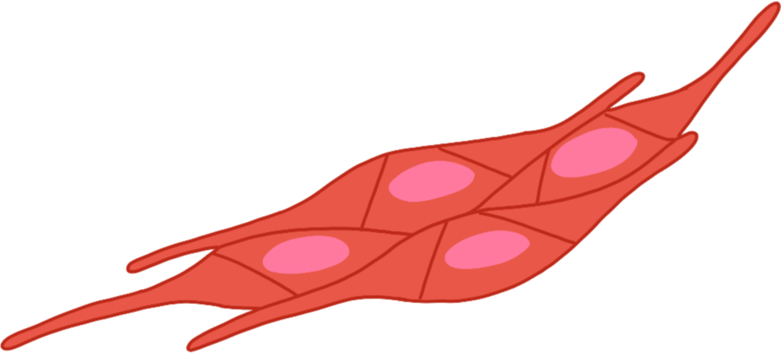

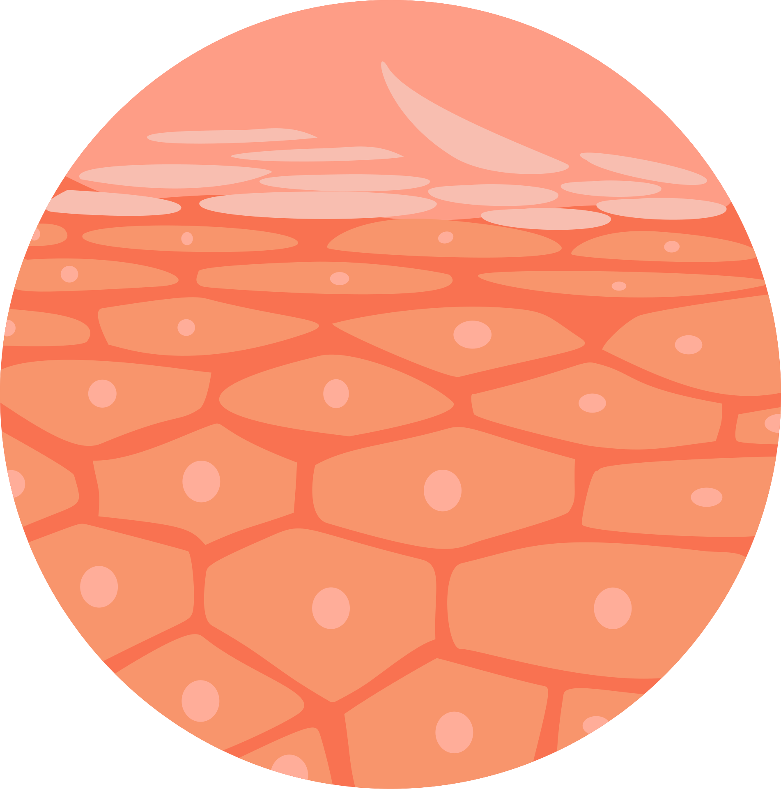
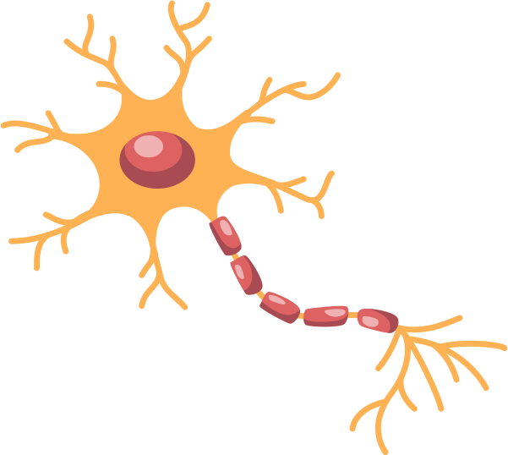

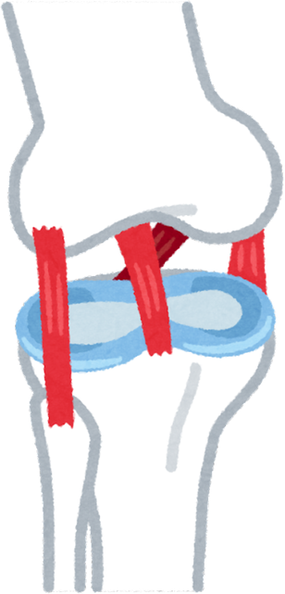
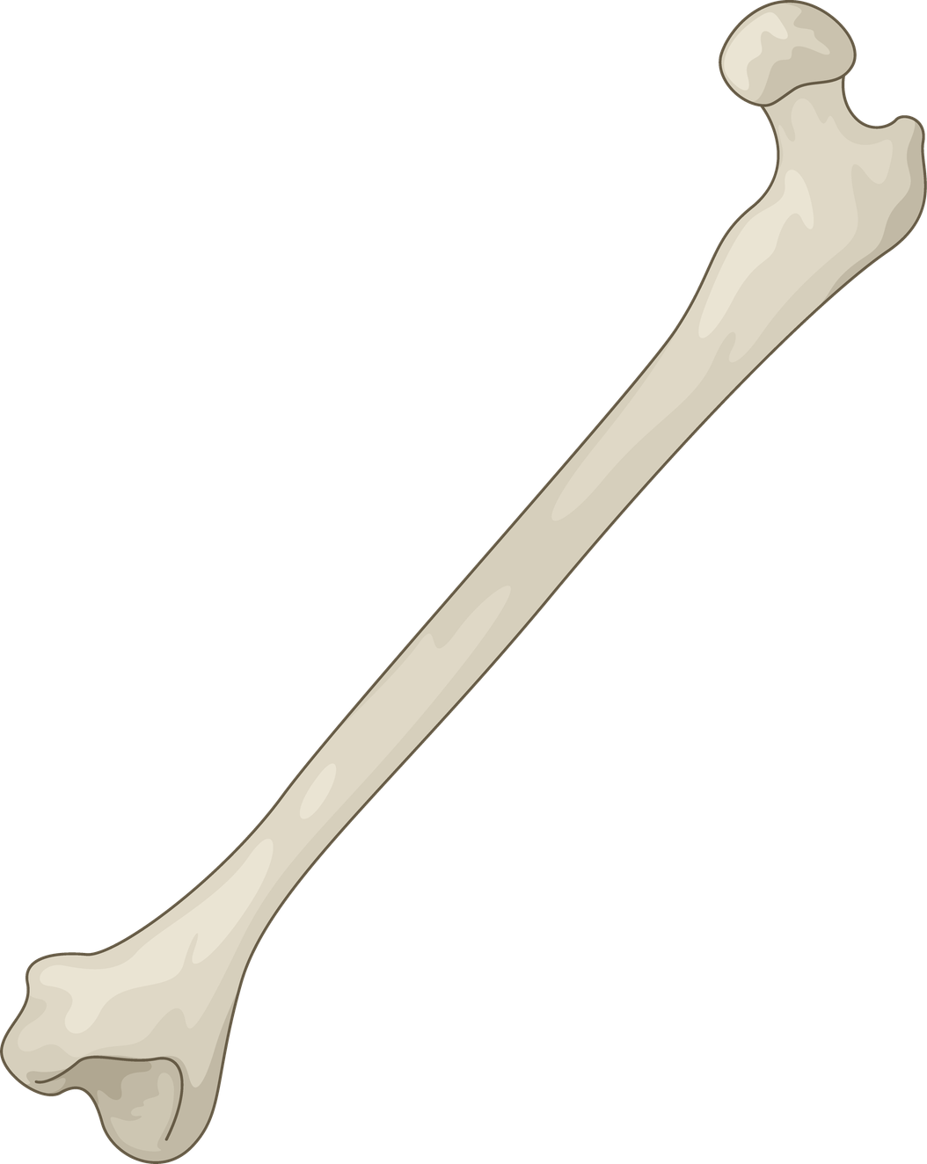
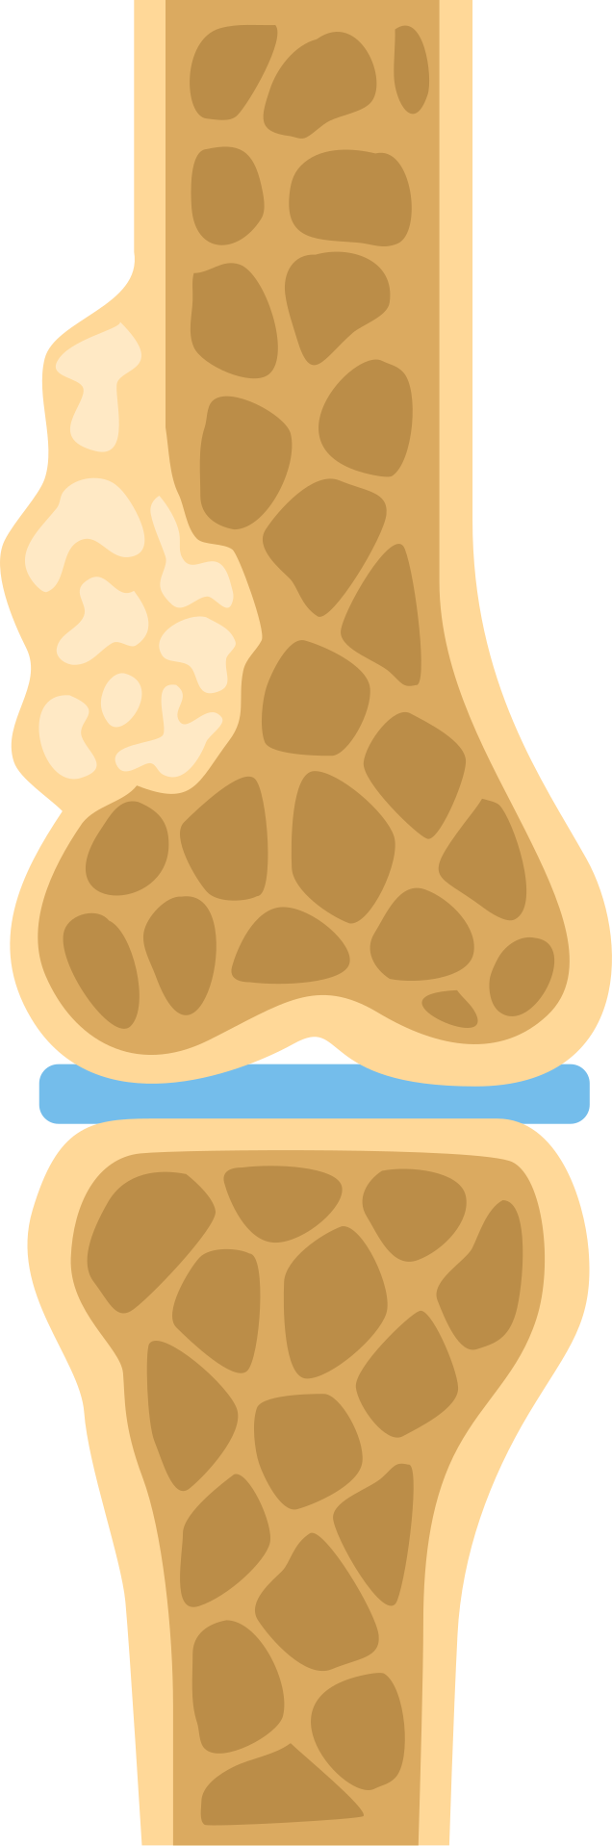
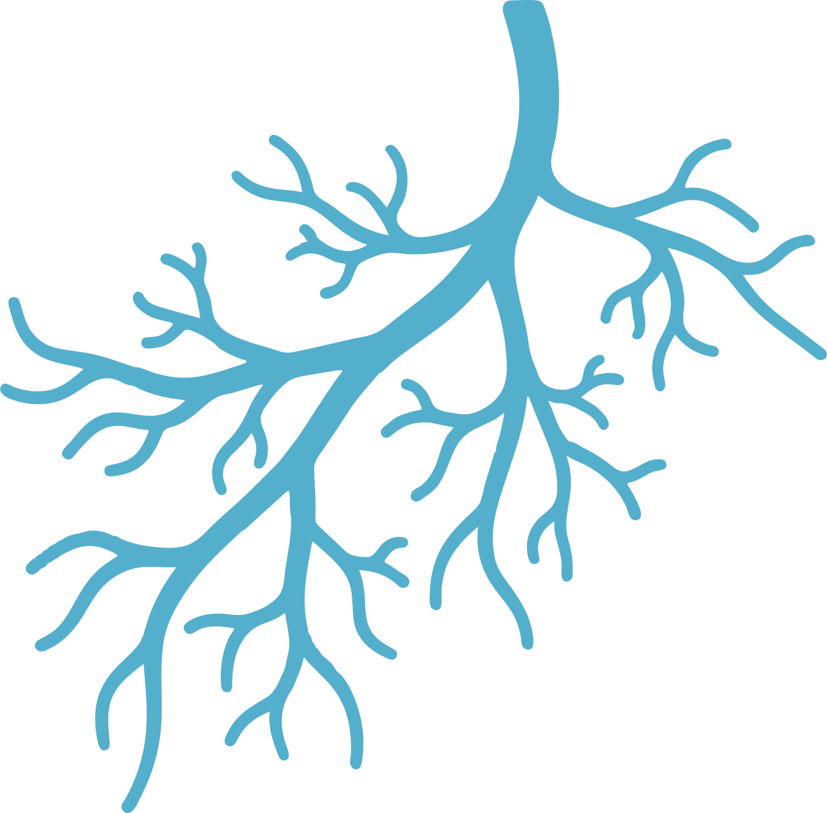
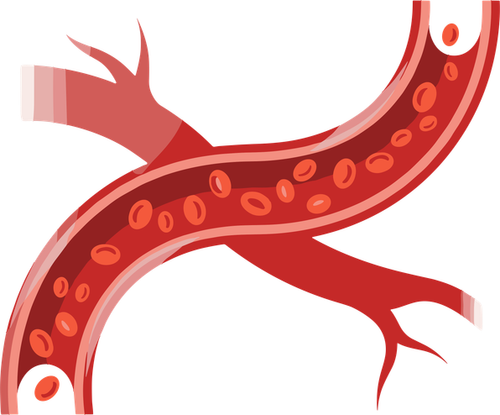
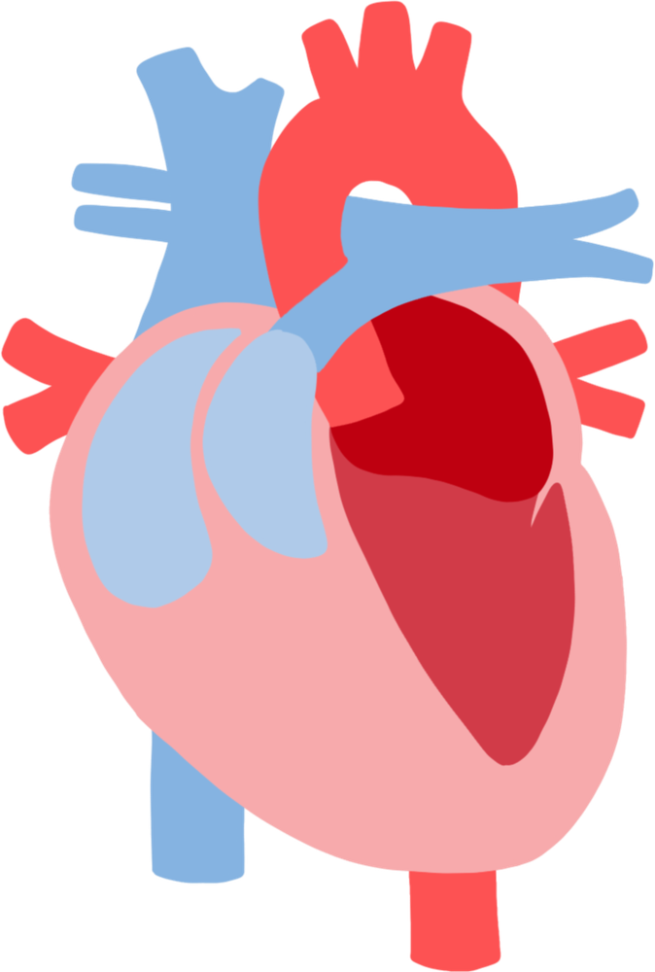
connective tissue
cornea/sclera
skin
WHAT EYE/TISSUE CAN I DONATE?
tendons
nerves
bone
ligaments
cartilage
arteries/veins
heart valves
Notes:
What eye/tissue can I donate? - connective tissue, corneas/sclera, skin, nerves, tendons, bone, ligaments, arteries, veins, heart valves, cartilage.
It’s also important to note that after tissue is recovered it can be preserved and stored. This means that tissue and cornea transplant can have not only a local, but national or international impact.
You can truly donate so much of your body to help others!

Slide 43
IMAGE WARNING
The following images are of a eyes and tissue. You do not have to look.
Notes:
Image Warning
The next images are of eyes and tissue.

Slide 44
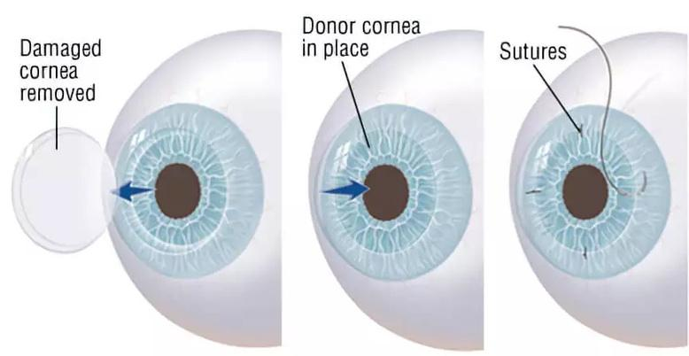
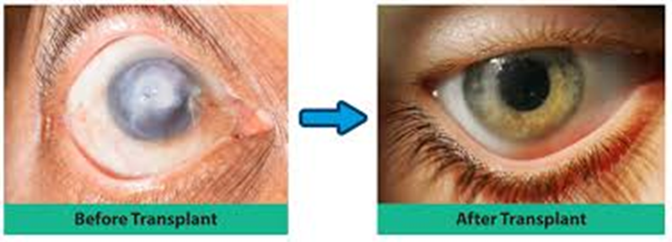
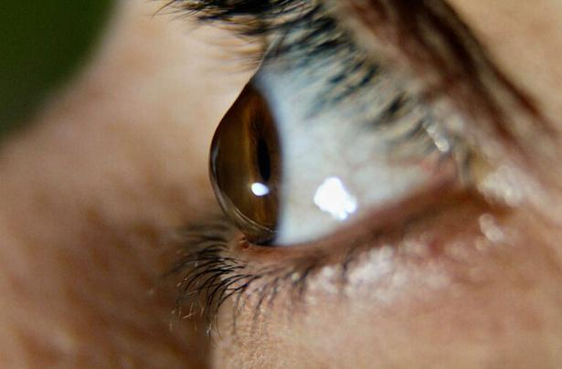
THE IMPACT OF CORNEA DONATION
Before - cloudy, distorted, blocked vision
After - restored sight
Eye trauma/chemical spill or burn
Keratoconus
Notes:
The impact of cornea donation
· Misconception that the entire eye is donated and transplanted into another person
· Only the cornea and sclera are transplanted
o (most common) cornea – clear, top layer of the eye. Looking through cornea right now.
o (less common) sclera – white part of the eye
· Before a cornea transplant a persons vision could be cloudy, distorted, or blocked. What conditions lead to needing a cornea transplant?
o Eye trauma
§ Chemical spill or burn
o Keratoconus
§ Malformation, cone-like shape of the cornea. Distorts vision.
§ Fun fact: Steph Curry (a famous basketball player) has keratoconus. He uses corrective lenses to see but if it gets worse, may need a transplant in the future.
· After a cornea transplant sight is restored after removing damaged cornea and replacing it with a donor cornea.

Slide 45
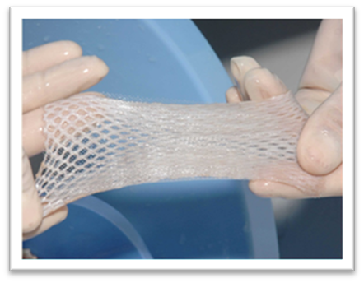
THE IMPACT OF SKIN GRAFTS
  Saves the lives of people with severe burns
  Graft placed over the wound
  Prevents infection, regulates body temperature, replaces/repairs lost skin
Notes:
The impact of skin grafts
· Typically used to help heal severe burns
· The graft is placed it over the wound
· Shaped like a thin sheet with holes to allow oxygen to reach the injury.
Skin grafts help prevent infection, regulate body temperature, and replace/repair lost or damaged skin.

Slide 46
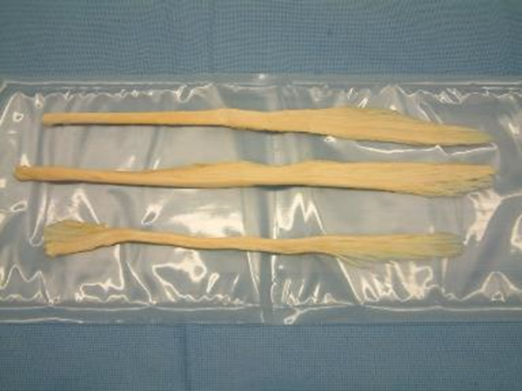
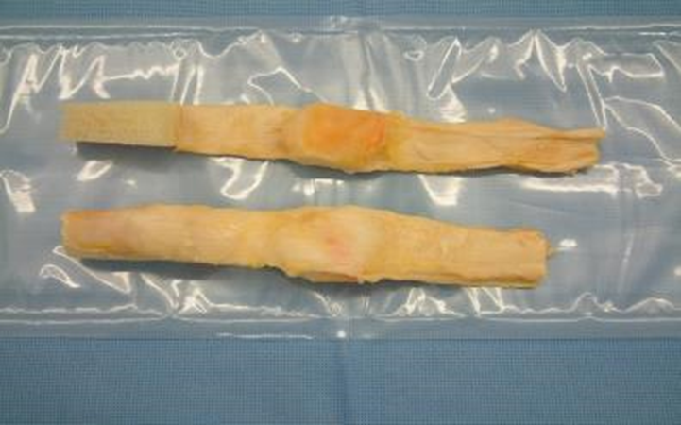
THE IMPACT OF TENDON & LIGAMENT REPAIRS
  Common: tearing an Achilles Tendon or ACL
  Athletes are susceptible, but can happen to anyone!
  Transplant may be the only option for a full recovery
  Restores mobility, eases pain, scaffolds healing
Tendons
(muscle-to-bone)
Ligaments
(bone-to-bone)
Notes:
The impact of tendon and ligament repairs
· Achilles tendon or ACL tears are common
· We hear all the time about athletes tearing an ACL, or you may know someone who has personally tore a tendon or ligament, athlete or not.
· Many individuals may need a transplant to get back to peak performance, sometimes it is their only option for a full recovery
Something cool about tendon/ligament repairs is that they are so versatile. They do not have to replace the same tissue one-for-one. For example, a recovered Achilles tendon can repair someone else’s Achilles tendon, BUT it can also repair other tendons in the body. So, the transplanted tissue does not have to be from the exact same body part as the injury..
Tendon/ligament transplants can restore mobility, ease pain, and scaffold healing.

Slide 47
IMAGE WARNING
The following image of a tissue transplant has blood and stitches. You do not have to look.
Notes:
Image Warning- want to show you an example of a tissue transplant.
This will have blood and stitches.
You don’t have to look, now is your chance to look away.
*pause briefly

Slide 48
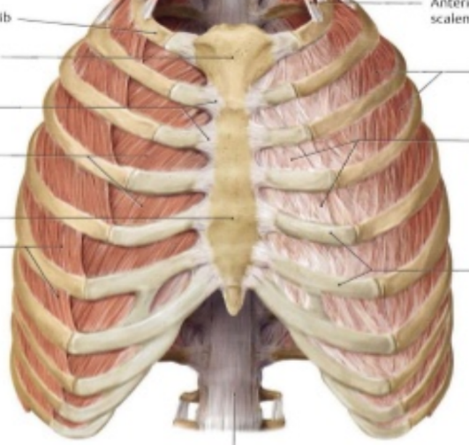
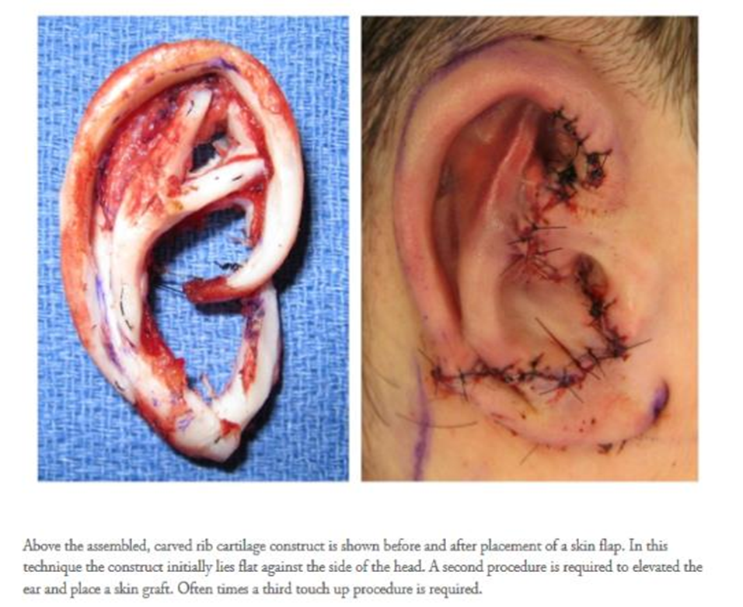
Rib Cartilage ⟶ Outer Ear Structure
Notes:
Rib cartilage to an outer ear reconstruction
· This is actually a donor’s rib cartilage [point to ribs] that’s been recovered and reconstructed into an outer ear structure.
· Outer ear provides protection, improves/amplifies hearing, prevents dust and debris from getting into ear canal, and structure to support garments such as glasses/sunglasses/masks/air pods/etc.

Slide 49


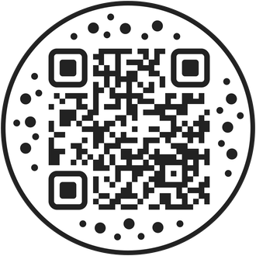
Signing Up
How to Register:
  DMV
  Online
  iPhone health app
www.donatelifenw.org/content/register-now
Notes:
Signing up
· How can you be part of this?
· You can register:
o DMV (when you get your permit, license, or ID)
o iPhone Health App (when you are 18)
o Online: In Oregon some one who is 13 can declare their intent to be an organ donor. In Washington that age is 15.5.
o NO limitations to signing up (anyone can register regardless of health status, physical ability, gender identity, sexual orientation, etc.)
§ iPhone Health App registers you on the National Registry (meaning no matter what state you live in, you are a registered organ donor), but you do need to be at least 18 years old to sign up on the National Registry
§ Online at www.donatelifenw.org/content/register-now.

Slide 50





Signing Up
Have a conversation with your family
Regardless of your decision
Everyone’s informed and can respect your wishes
Advocate for you, if you can’t
Notes:
We highly encourage you to have a conversation with your family:
o Whether you want to be a donor or not and also find out your family’s wishes too
o Talking to your family about donation wishes is important for many reasons:
Family can ideally respect your wishes
Everyone is on the same page
Your family does not have to carry the burden of guessing what you wanted.
Your family can advocate for you if you are ever in a situation where you cannot speak for yourself
If you are under 18, your parent/legal guardian has the final say and can override your decision. This is why it is even more imperative to discuss your decision with your family to ensure they know what your wishes are and why. Once you are 18, your registration is legally binding and cannot be overridden by anyone.
o Tip to start the conversation: take the rack card (that will be handed out at the end of class along with swag items) and present it to your family. Share that you learned about organ donation in class today, and it is required to learn about it in high school now. Ask if they are they organ donors? What do they think about the topic?

Slide 51

Signing Up
Help those in your community!
Especially those from your same racial/ethnic background
Check out this video to learn more!
Notes:
Help those in your community
o Especially those from your same racial/ethnic background.
Show a video created by CLA that dives deeper into this topic.
Alarmingly, systemic racism and numerous inequities in the healthcare system have led to a decrease in access to healthy choices and access to healthcare in communities of color. These, and a variety of other factors, such as mistrust in the medical system, contribute to the fact that there is even more of a need for transplants with some racial and ethnic groups, due to a high incidence of conditions such as high blood pressure or diabetes, both of which can lead to the need for a kidney transplant.
People belonging to communities of color can likely to suffer from end-stage kidney disease, often the result of high blood pressure and other conditions that can damage the kidneys.
60% of people on the national transplant waiting list are from multicultural communities and reflect only 30% of the number of transplant recipients. Until these percentages are equal, this is an inequity.
UNOS has recognized inequities in organ allocation and has recently changed the algorithms by which they determine the candidate in the most need for an organ, as well as restructuring geographic boundaries for transplant centers.
Organ donors and recipients are NEVER matched based on race or ethnicity. However, there is a higher chance of a successful outcome when the donor and recipient come from similar racial/ethnic backgrounds due to blood types and tissue markers being more common among certain racial/ethnic groups. More diversity in registered donors will increase access to matching organs and lives saved.

Slide 52
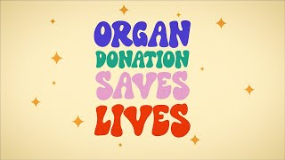
Notes:
*Click on the play button in video with your cursor, DO NOT USE KEYBOARD!
*If video is not working in slideshow, go to pre-loaded video in different tab.
https://www.youtube.com/watch?v=1NOnnlIldTc
*Enable closed captions, and ensure Quality is set to 1080p HD when clicking on the cog icon.
Video takeaway: We know recipients are not matched based on race and ethnicity, but it is important to have as many people registered as possible because when we have a diverse pool of donors it increases the chance of someone finding their perfect match. Additionally, if people match and happen to be from the same racial/ethnic background, there is a higher chance for a successful transplant!

Slide 53
WHY PEOPLE SAY “NO” TO DONATION
Can you guess?
?
?
?
?
?
?
Notes:
Why people say “no” to donation
The reality is, not every says “yes” to organ donation. And that’s ok. But why is that? Let’s think critically about why people may choose not to register as donors.
Give students an opportunity to brainstorm why they think people don’t want to be organ, eye, and tissue donor.
Hint: many reasons were mentioned in the previous video.

Slide 54
WHY PEOPLE SAY “NO” TO DONATION
WHY PEOPLE SAY “NO” TO DONATION
Inaccurate tv/media portrayal
Compromised medical care
Religious beliefs
Illegal organ trade
Worry of additional cost
Funeral arrangements
Don’t think they are eligible
Notes:
There are various reasons why people may opt out of organ donation. A lot of them are valid, however many are rooted in misinformation. Let’s go over some of these answers and talk about why these common myths are inaccurate.
· Compromised medical care
o Myth: The doctor will let me die if they know I am a registered organ donor, they just want my organs
o Fact: In an emergency, the doctors’ #1 priority is to save your life. They went into the field for a reason; they took an oath. Also, the medical team and organ donation team are completely separate. The doctor does not know your donation status or have access to the donor registry.
· Religious beliefs
o Myth: my religion does not support organ donation
o Fact: all major religions support organ donation, however if you are unsure, please talk to your spiritual leader. Even if you think the answer is no, you might be surprised!
Inaccurate tv/media portrayals of donation and transplant
Myth: What I see on tv and in media must be true
Fact: TV and media often have inaccurate portrayals of donation and transplant for entertainment value or only give part of the information. Always check your source.
· Illegal organ trade
o Myth: corrupt system where organs will be sold for money
o Fact: it is illegal to sell human organs in the United States, and the organ donation system is heavily regulated by the government with multiple safeguards in place. The OPO carefully tracks and reports organs recovered under strict metrics that must be met to remain operational.
· Worry of additional cost
o Myth: organ donation is extremely expensive
o Fact: organ donation is completely free for the donor's family. It is a selfless gift. However, all life-saving efforts by the hospital prior to the donation process do cost money (ex: procedures, scans, medication, hospital stay, etc.)
Funeral arrangement
Myth: I can’t have an open casket or viewing if I am an organ donor. I can’t be cremated if I am an organ donor.
Fact: All these final wishes can happen along with organ donation. Recovery is done in a respectful way. Recovered organs and tissue are replaced with prosthetics and all incisions are closed. Skin is taken from the backside of a donor or an area that will be covered by clothing.
Don’t think they are eligible
Myth: I’m too sick/old to donate my organs.
Fact: ANYONE can register to be a donor regardless of health, medical condition, age, gender, or sexual orientation. It is determined by a doctor at the time of someone’s passing if they are eligible to be a donor. In fact, 1 out of 3 deceased organ donors is over the age of 50.
There are many reasons people choose not to become organ donors, but we want to make sure everyone has the facts so they can make informed decisions, not ones based on misconceptions or fear. If you have ever heard any of these myths and they make you pause, please consider reflecting on some of the things you learned today before making a decision.

Slide 55
ANY QUESTIONS?
Notes:
Transition: any questions?

Slide 56
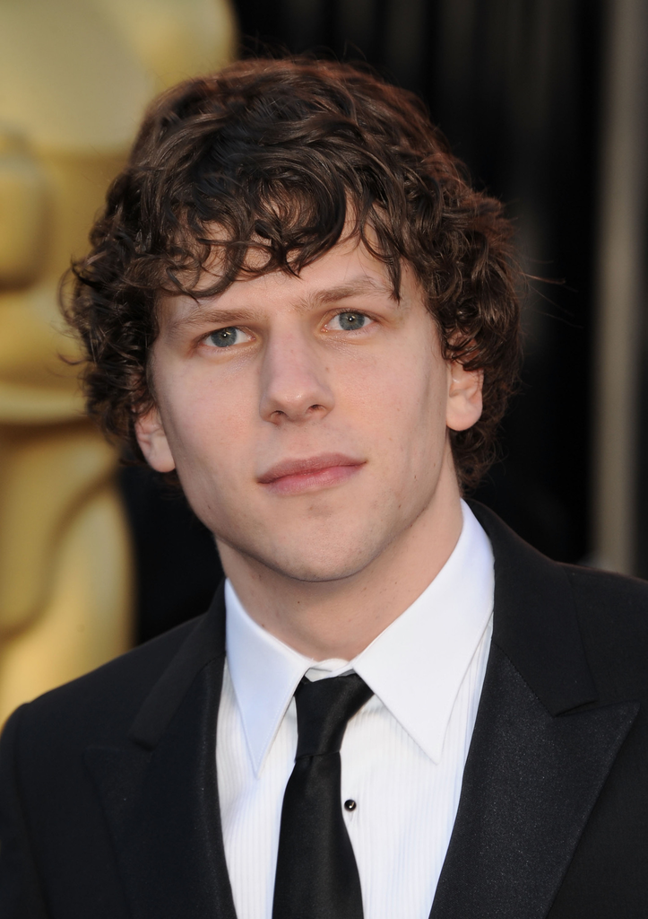
Living Donation
Do you know Jesse Eisenberg?
  Famous American actor (The Social Network, Now You See Me, Batman V. Superman, etc.)
  Extremely passionate about organ donation and giving back altruistically
  December 2025 - donated one of his kidneys to a stranger
Notes:
Living donation
Do you know Jesse Eisenberg?
He is a famous American actor and playwright (popular movies include The Social Network, Now You See Me, Batman v. Superman).
He is also extremely passionate about organ donation and giving back altruistically. He is known to regularly donate blood and recently spoke about the importance of organ donation and helping people on the transplant waitlist.
In December 2025, Jesse underwent surgery in New York to donate one of his kidneys to a stranger in need. He is praised and admired for his act of kindness and continues to advocate for living kidney donation.

Slide 57


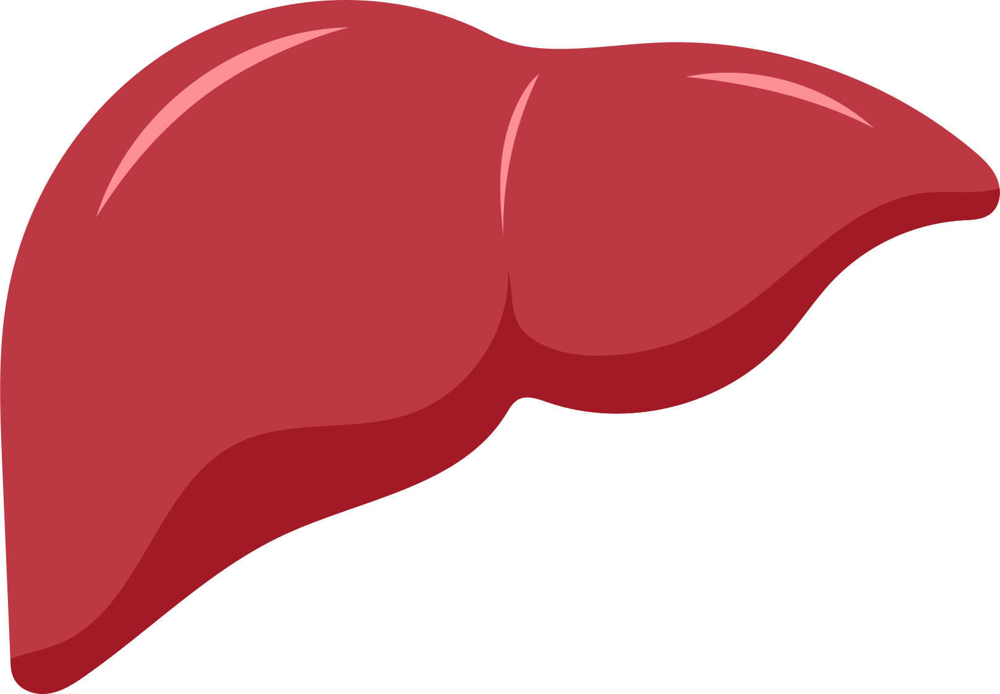
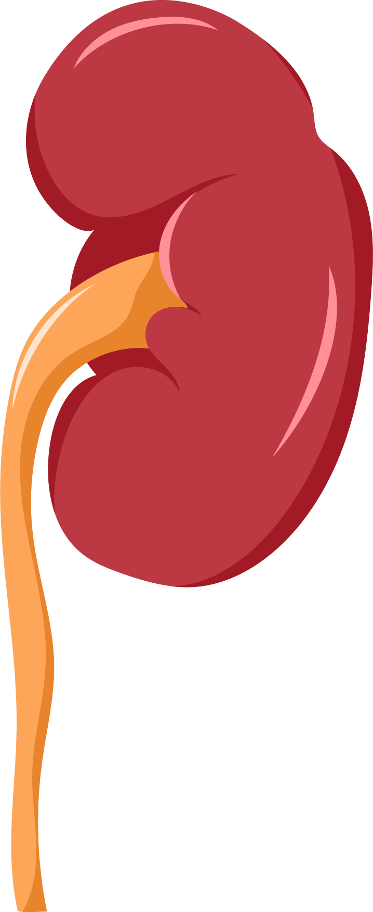


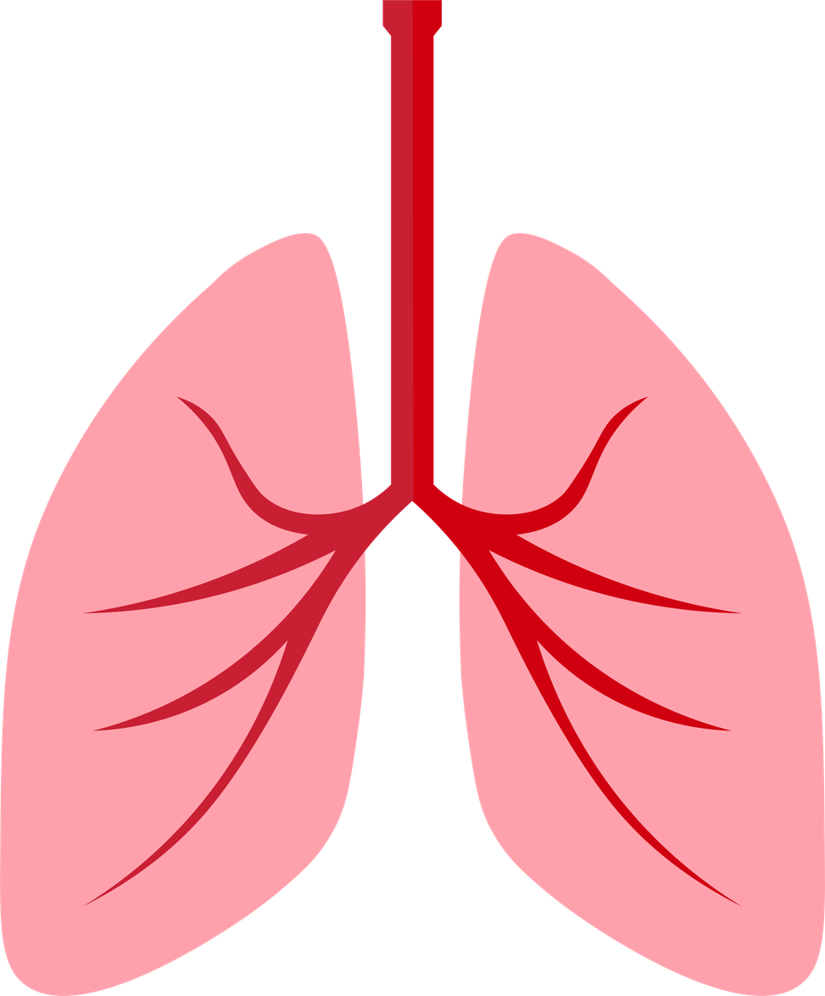
What is Living Donation?
Donating an organ while you are still alive
A kidney, part of the liver, small portion of the lung called a lobe
Kidney donation is safe, common, and minimally invasive. Donors continue to lead healthy lives.
Not the same as deceased organ donation, has nothing to do with the donor registry or registering at the DMV or online.
Generally, must be at least 21 years old to participate.
Notes:
What is living donation?
· It is donating an organ while you are still alive.
Fact #:
*click*
1. What organs can you donate while alive?
a. 1 of your kidneys (most people have 2 and only need 1 to survive), part of your liver (livers can regenerate and will grow back in the donor and recipient), small section of your pancreas or intestine, and a very small portion of your lung called a lobe.
*click*
2. Recovery
Procedure is very safe and minimally invasive. Donors continue to lead healthy lives post operation. Additionally, if living donors ever end up needing a transplant, they are placed at the top of the waitlist because of their altruistic act.
*click*
3. Living vs. Deceased Donation
Living donation is NOT the same as deceased organ donation. It has nothing to do with the donor registry (like when you register at the DMV or online) or OPOs. Cascade Life Alliance/DLNW does not facilitate the living donation process, they simply educate on the topic. This is a program you apply for separately and living donation is done by transplant hospitals.
*Another note: blood, bone marrow donation are also completely separate programs.
*click*
4. Age requirement
Generally, transplant hospitals require participants to be at least 21 years old to be a living donor..
While high school students cannot sign up for living donation yet, it is still important to be aware that this is an option for later down the road if students ever want to participate in it.

Slide 58
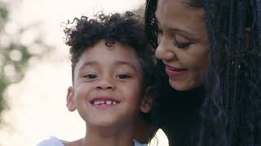
Notes:
OPTIONAL: Interview Video (6 minutes, 30 seconds)
· Now we want to make this more personal. We understand it can be easy to get lost in the data and numbers and not fully grasp the impact of organ donation.
· This last video interviews donor families and recipients who have been personally touched by organ donation and transplantation. They are all locals in the PNW.
· Content warning- may be emotional, practice self-care. This video is about 6 minutes long.
*Click on the play button in video slide with your cursor, DO NOT USE KEYBOARD!
*If video is not working in slideshow, go to pre-loaded video in different tab.
https://www.youtube.com/channel/UCrCGTyXGFDyhkVBG0vGw7Cw
*Enable closed captions, and ensure Quality is set to 1080p HD when clicking on the cog icon.

Slide 59

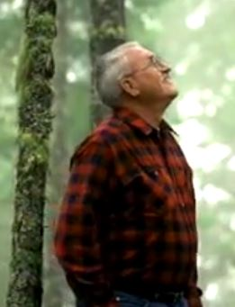
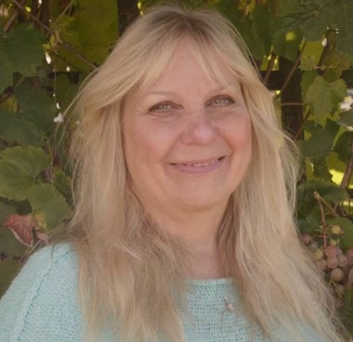
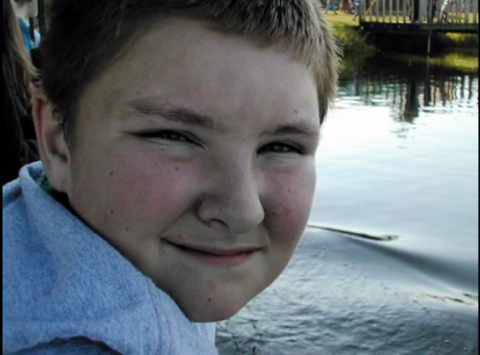
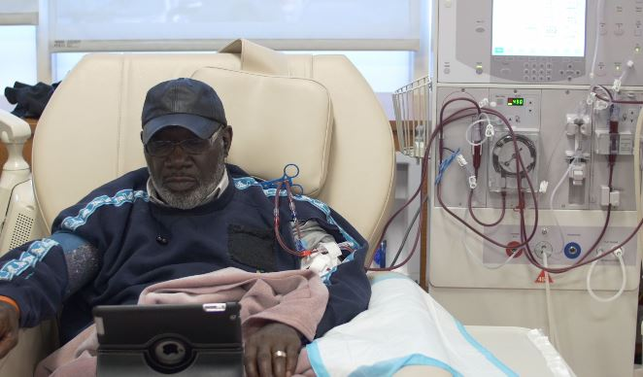
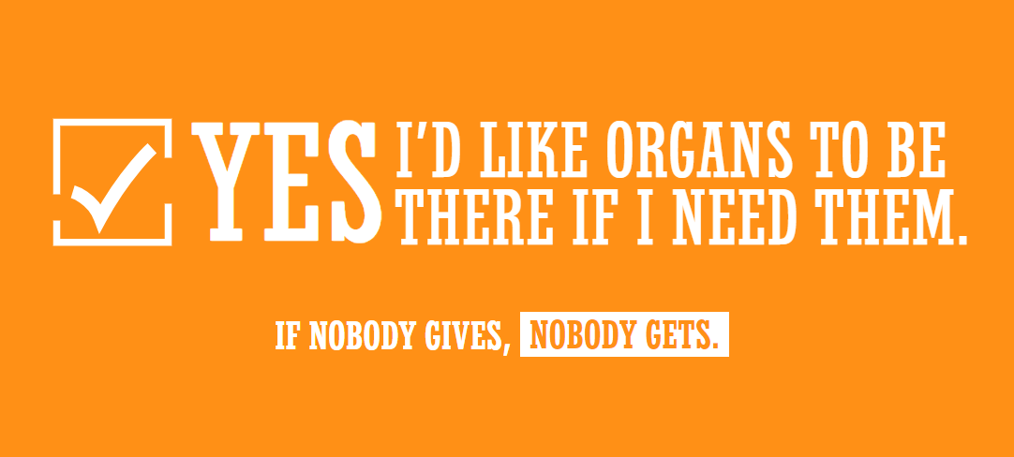
DLNW Videos
Alysia’s Story
John’s Story
Jan’s Story
Hayden’s Story
The Waiting List
Notes:
Alysia’s story about being on the transplant waitlist is 1 minute and 32 seconds.
John’s story about being a cornea recipient is 53 seconds long.
Jan’s story about being a tissue recipient is 1 minute 28 seconds.
Hayden’s donor story told by his mom, Anne, is 3 minutes 38 seconds.
These individuals never thought they would be in the situation they were placed in, and you truly never know what’s going to happen. It is very important to consider what you want your decision to be and communicate that with your loved ones.
How the National Organ Transplant Waiting List Works video is 1 minute 35 seconds.
The PSA Yes, I’d Like Organs To Be There if I Need Them is 30 seconds.

Slide 60
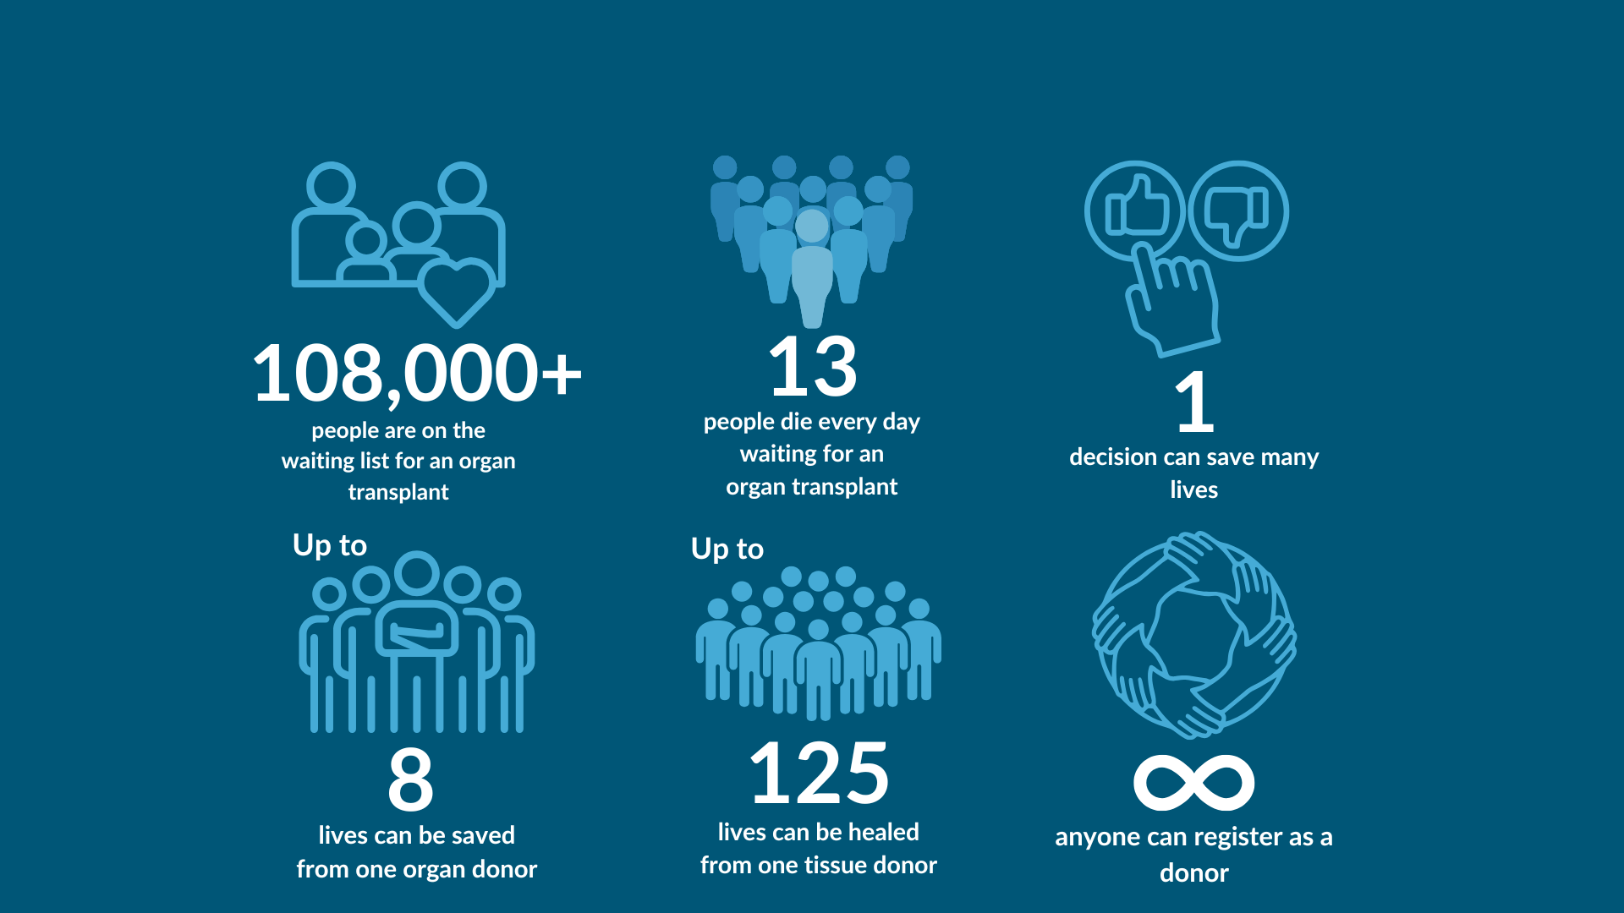
YOU HAVE THE POWER TO SAVE LIVES!
Notes:
Wrap-up/key takeaways
· More than 109,000 people are currently waiting for a life-saving transplant.
· 13 people die per day waiting because there is a shortage of organ donors and they couldn’t find a match in time.
· Your 1 decision can save many lives.
· You can save up to 8 lives through organ donation.
· You can save/enhance up to 125 lives through eye and tissue donation.
· ANYBODY 13 years old and older can register, 15.5 in Washington.
Bottom line – you do have the power to save lives! It’s as simple as saying yes to organ donation. This is a life-saving movement that YOU can be part of today!

Slide 61


Student Leadership Opportunities
Be a Go Recycle Yourself Student Ambassador or join Student Organ Donation Advocates (SODA)
Leadership opportunities & volunteer hours look good on a resume or application!
donatelifenw.org/content/students or SodaNational.org/Students
Notes:
What else can you do?
If you are interested in hosting peer education events at your school, you can contact:
Donate LIfe Northwest we offer leadership options for students who want to share the importance of organ and tissue donation. You can contact us to learn more about these opportunities.
SODA chapter
· If students are particularly moved by this mission, have them start a SODA chapter at school
· SODA stands for Student Organ Donation Advocate
· Nationwide chapters
· Like a club at school- great leadership opportunities, volunteer hours, receive funding, looks good on a resume
· Work with CLA
Learn how to get started on their website/can provide students with SODA flyer handout

Slide 62




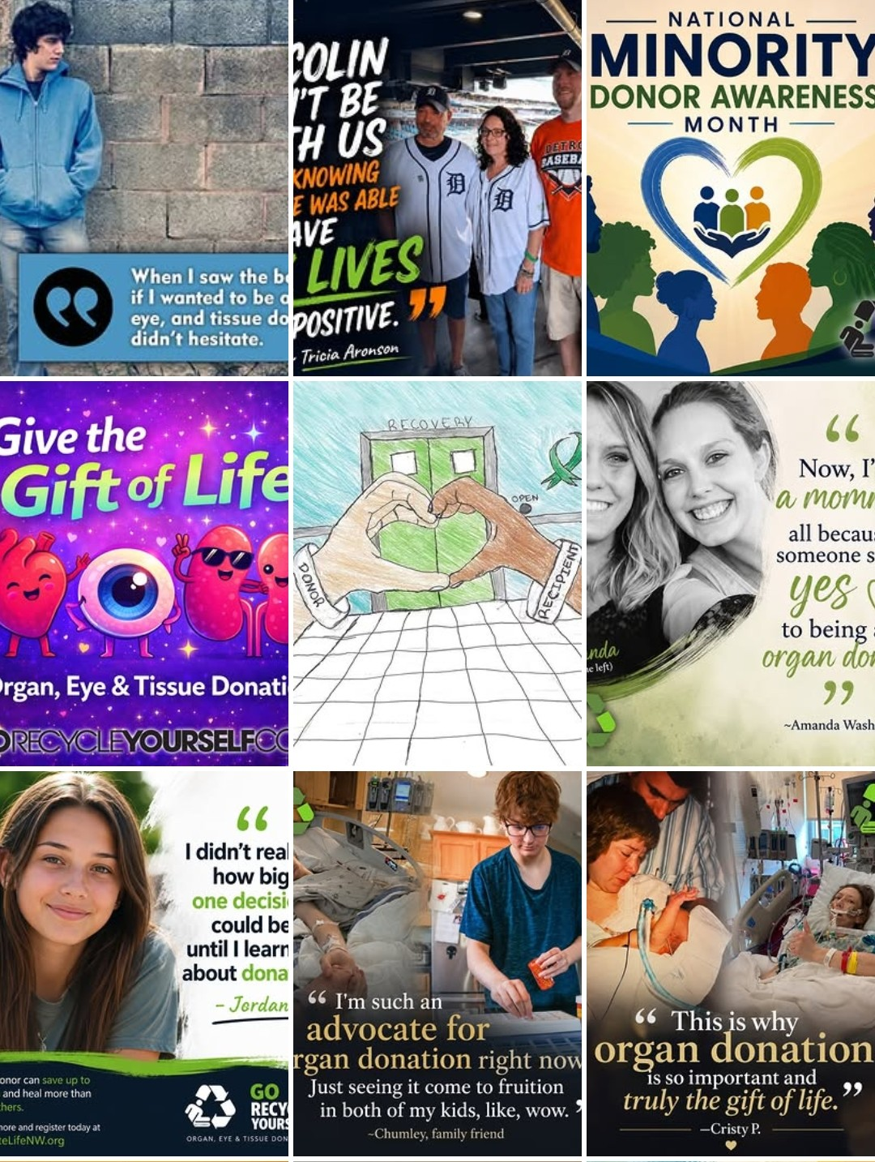
RESOURCES
DLNW website:
donatelifenw.org
CLA Website: cascadelifealliance.org/outreach
GRY Instagram:
@gorecycleyourself
DMV Website: oregon.gov/odot
Notes:
Resources for students who want to learn more
· CLA website
o Learn more about what the organization (who created this presentation) does and organ donation
o Register as a donor from our website
· Go Recycle Yourself social media
o Stay up to date with DLNW and GRY on Instagram!
· DLNW website
o More educational resources
o Register as an organ donor!
· DMV website
o More info about getting your license and the question “Would you like to be an anatomical donor?”

Slide 63


Español
THANK YOU!
PLEASE COMPLETE OUR SURVEY TO GIVE US FEEDBACK :)
English
Notes:
Thank you!
Post-Questionnaire
· Please have students complete our post-questionnaire (through whichever method you see fit) for our data collection and to give us feedback so we can improve this curriculum.
· *if there is not time for Q&A, please have students ask their questions under the “Additional questions/comments?” section and we will get back to you with the answers!
· Collect questionnaires if paper forms

Slide 64
Q&A Session
Notes:
Q&A time
· Please be mindful of your peers and respectful when asking questions
· Students raise hands
· Reference FAQ document if needed
Record any questions you don't know the answer to, email us, and we will follow up with responses for you to share with the class

