Slide 1



Recycle Yourself
Save lives through organ, eye, and tissue donation!
Notes:
Introduce yourself!
Who are you? What’s your job? Why are you here?
If your job is related to donation/transplantation, how did you choose your job?
If you are a volunteer, what motivates you to educate people about donation? (don’t tell your whole story yet)
As I go through my presentation, raise your hand if you have a question! I’ll do my best to answer (but I am not a health professional).
Today we will be talking about organ, eye, and tissue donation, how the process works, some of the science behind it, and the impact it can have.
It is important get all the facts and be able to ask any questions you have on this topic so you can make an informed decision on whether you want to become a registered donor or not.
We are not here to register you as an organ donor. This is your choice to make and share with your family.

Slide 2
This presentation contains sensitive content regarding the discussion of death, grief, illness, and the showing of medical images.
Be mindful and respectful of everyone’s experiences, feelings, and attitudes regarding the topic of organ, eye, and tissue donation.
Please care for yourself and reach out for support if needed.
Notes:
Please review this content warning with students prior to the presentation.

Slide 3
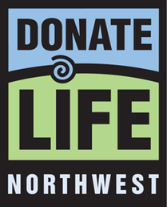

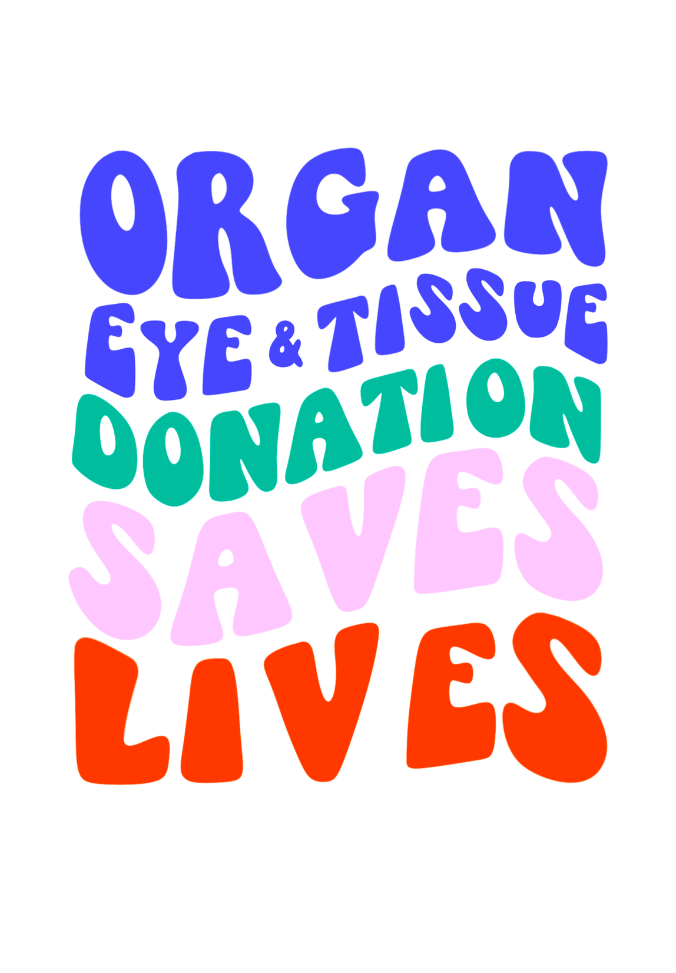


Eye Bank
Outreach & Education
Organ Procurement
Tissue Bank
Notes:
There are 4 organizations involved in organ, eye, and tissue donation in Oregon and SW Washington (Donate Life Northwest, Vision Gift, Solvita, Cascade Life Alliance).
· Donate Life Northwest - community outreach & education
· VisionGift - eye bank for Oregon and SW Washington
· Solvita - tissue bank and facilitates tissue donation nationwide
Cascade Life Alliance (CLA) - Oregon's federally designated Organ Procurement Organization (OPO). They are the ones who go into the hospital to recover the organs for transplant!
This presentation is made in collaboration with all four organizations.

Slide 4

Questions or connections?
Notes:
Any questions before we get started? Any connections to donation that anyone would like to share?

Slide 5
What is organ, eye, and tissue donation?
Notes:
Before going to the next slide, ask a few students for their definition if they’d like to share.

Slide 6
Organ, eye, and tissue donation is . . .
The opportunity to donate organs, eyes, and/or tissues after death to save or heal the lives of people who need them.
One organ donor can save up to 8 lives &
One cornea and tissue donor can save or enhance 125 lives.
Notes:
Students may also bring up living donation. We’ll talk more about that later in the presentation, but for now we’ll focus on deceased donation as that’s related to the registry connected to the DMV.

Slide 7
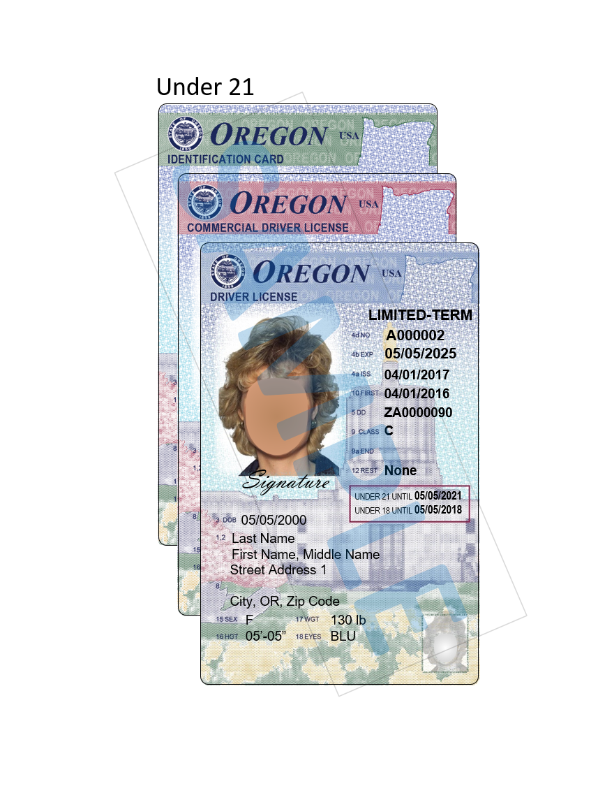
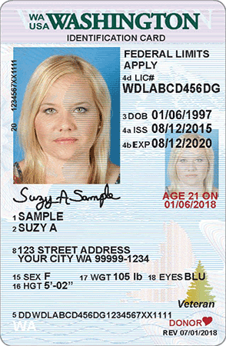
Have you been to the DMV to get your driver’s permit, license, or ID?
Saying yes to being an organ donor means; After I die, I wish to donate organs, eyes, and/or tissue to save someone’s life, restore someone’s vision, and/or restore someone’s mobility.
D
Notes:
A lot of student’s first experience with organ, eye, and tissue donation comes when they visit the DMV.
Ask for a raise of hands. How many of you that have a license, permit, or ID already or you will be getting it soon? For those of you who have been to the DMV anyone said yes and have a “D” or a heart on your permit or license?
If you have not been to the DMV yet, know that when you go to get your permit, license, or ID, they will ask you “Do you wish to register as an organ, eye and tissue donor?”
Saying yes means you are joining the Oregon Organ Donor Registry, and confirming that (click text)
After I die, I wish to donate…
When you register at the DMV, you are agreeing that you want to donate organs, corneas, and tissue. If you would like the option to choose what you feel comfortable donating, you can register online, where there is a checklist of options for donation.
Alternatively, if you do not want your name in the donor registry data base or do not want to have the D or heart on your license, but still want to be a registered donor, you can register online. In fact, online you can get a username and password and can change your status at any time.
To change your status through the DMV it involves getting a new license which costs $$.

Slide 8
Why is there a need for organ, eye, and tissue donors?
Notes:
There are many people in our country and around the world that are experiencing organ failure.
Organ failure is when one or more of a person’s organs stop working properly.
One treatment is receiving an organ transplant.

Slide 9
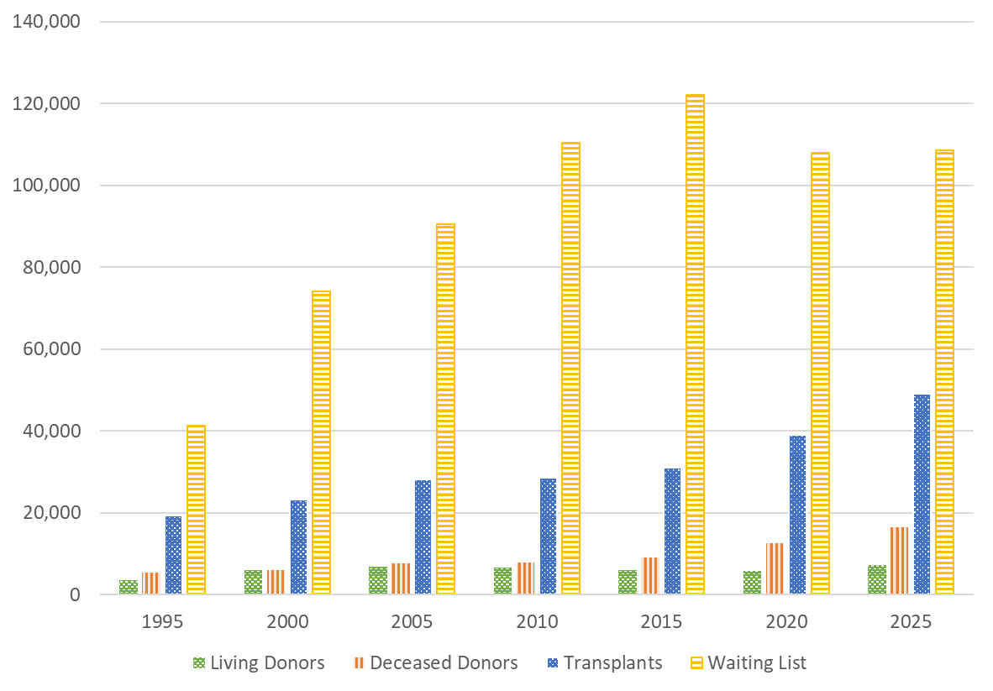
The Need for Organ Donors
Every 8 minutes someone is added to the waiting list
On average 13 people die each day while waiting for a transplant.
Notes:
The need for healthy, transplantable organs has reached crisis levels throughout the United States. As you can see, since the 1990s, the number of deceased and living donors has stayed somewhat constant, whereas the number of people needing an organ transplant has risen dramatically. There are MANY waiting for an organ transplant, but comparatively few donors.
This data shows ONLY the number of people on the waiting list for organ transplants.
This data does NOT reflect the hundreds of thousands more people who could benefit from tissue and cornea transplants. Actually there is no waitlist for cornea or tissue transplants.
Neither does it reflect those WAITING to be placed on the waiting list!

Slide 10

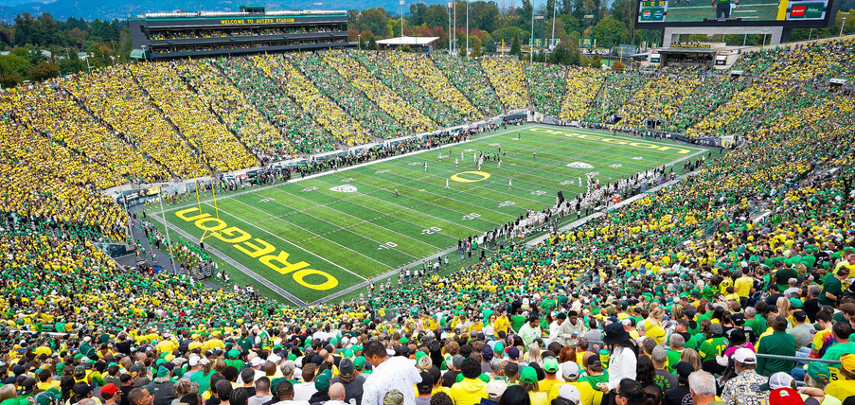
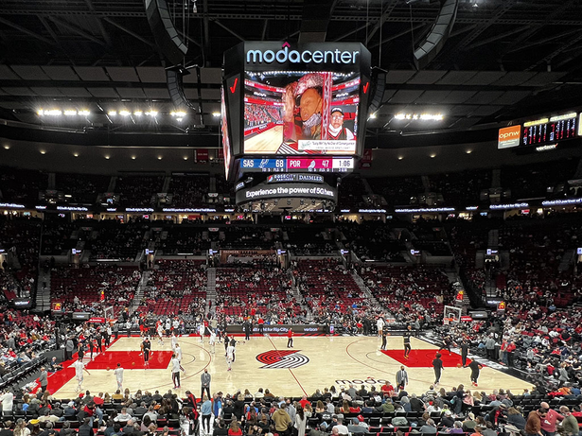
How many people are currently waiting?
Currently, there are over 109,000 people in the US on the transplant waiting list.
That number of people can fill:
Reser Stadium
Autzen Stadium
Moda Center
Notes:
Pause to ask students if they have a guess on the number of people waiting nationally on the waitlist.
Just how many people is 100,000. That amount of people could fill all three arenas with different people.
August 13, 2026 OPTN numbers: Nationally,109,815 candidates are on the waitlist. In Oregon,1,346 candidates are on the waitlist. In Washington there are 1,643 candidates.
Ask students what organ they think is in the most need. It’s the kidney! 86% of all people waiting are waiting for a kidney.
For the most current national and state data, visit
https://hrsa.unos.org/data/view-data-reports/national-data/
https://hrsa.unos.org/data/view-data-reports/state-data/.

Slide 11
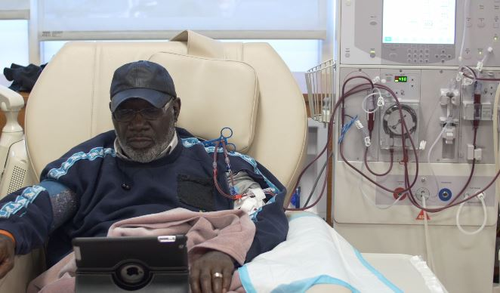

How do patients get on the waitlist?
Doctors refer sick patient to a transplant center.
A committee of doctors, surgeons, and hospital staff decide whether a patient is a candidate for transplant.
A transplant candidate is added to the national waiting list.
People stay on the national waiting list for days, months, or even years.
The Waiting List
Alysia’s Story
Notes:
Discussion prompt:
How do you imagine it must feel, waiting and hoping you’ll get your lifesaving transplant? Ask students for adjectives (scary, nerve-wracking, etc.)
Playing the “Alysia’s story” video is optional; it is 1 minute, and 32 seconds long.
Being placed on the waiting list is not automatic. Because there are so few organs available, professionals must be sure that an individual is stable – emotionally, physically, and financially – in order to ensure that they can take care of their new organ for the rest of their life.
Playing the “How the National Organ Transplant Waiting List Works” video is optional, it is 1 minute, and 35 seconds long.
Frequently Asked Questions
What determines whether people get on the list?
This decision is based on the status of the patient’s health, his or her medical and social history, and the expectation of their stability after the transplant takes place.
How long do people stay on the waiting list?
Those on the national waiting list may wait days, months, or even years. Many medical and logistical criteria impact the time an individual spends on the waiting list, including: • Blood type and size of organ needed • Distance between donor and recipient • Medical urgency • Immune-system matching
UNOS provides detailed statistics on the waiting list.

Slide 12




Kidney and liver
Transplants
Kidney Transplants
Heart Transplants
Kidney, liver, and heart
Transplants
Notes:
Locally there are four transplant hospitals that serve Oregon and SW Washington. All are located in Portland.
Legacy Health does kidney transplants
Providence does heart transplants
OHSU does kidney, liver, and heart transplants
The VA does kidney and liver transplant for veterans.
There is not a lung transplant program in Oregon. People in Oregon needing a lung transplant need to seek care in Seattle or in California.
Since these transplant hospitals are all located in Portland, it creates a geographical inequity. Candidates on the waitlists at these hospitals need to be able to get to the hospital if an organ is available in about a 2-hour window.

Slide 13
How does someone become a donor?
Notes:
Let’s talk about how someone becomes a deceased donor.

Slide 14


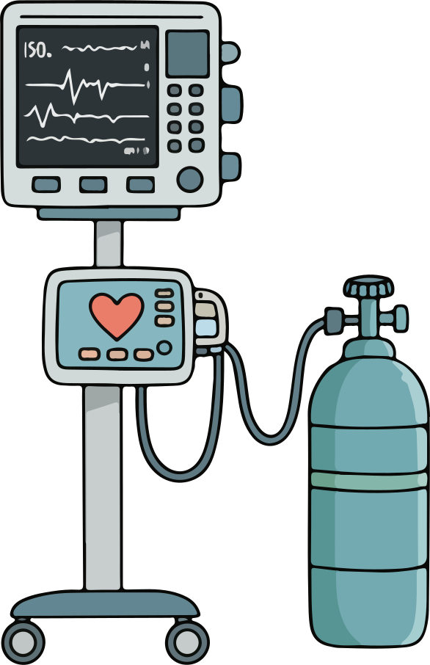


Organ Donors
Eye/Tissue Donors
Can pass away outside of a hospital
Must pass away in a hospital
Be connected to a ventilator
Does not need to be connected to a ventilator
Needs constant blood flow and oxygen
Stays viable longer w/o blood and oxygen & can be stored
Limited to 6 transplantable
organs
So much tissue possible to donate
Notes:
There is different criteria that determines if someone can be an organ or tissue donor.
· Organ donation has very strict medical criteria that must be met in order for the process to work and organs to stay viable.
· Eye/tissue donation does not have such strict medical criteria.
· For example (refer to slide):
Organ donation → must pass away in the hospital.
Eye/tissue → can pass away outside of a hospital.
Organ donation → needs to be connected to a ventilator (breathing machine found in a hospital). This forces the patient to breathe because they no longer can on their own due to severe injury. Breathing supplies oxygen to the organs.
Eye/tissue → does not need to be connected to a ventilator.
Organ donation → needs constant blood flow and oxygen. Organs will no longer be viable (healthy and functional) for transplant if they go too long without blood and oxygen.
Eye/tissue → stays viable for much longer without blood and oxygen.
Organ donation → limited to 6 transplantable organs.
Eye/tissue → incredible amount of tissue that can be transplanted, lots to choose from.
It is rare to become an organ donor and the need is extremely high. About 1% of all deaths lead to organ donation. Eye/tissue donation is much more common and gives the majority of people the opportunity to donate.

Slide 15
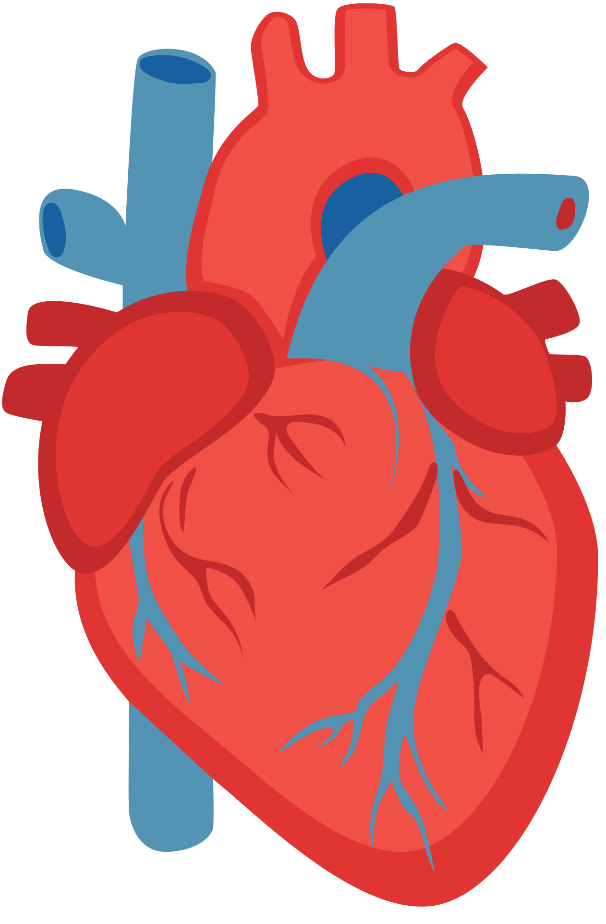
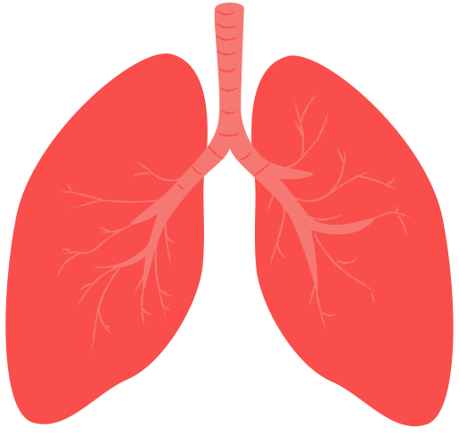
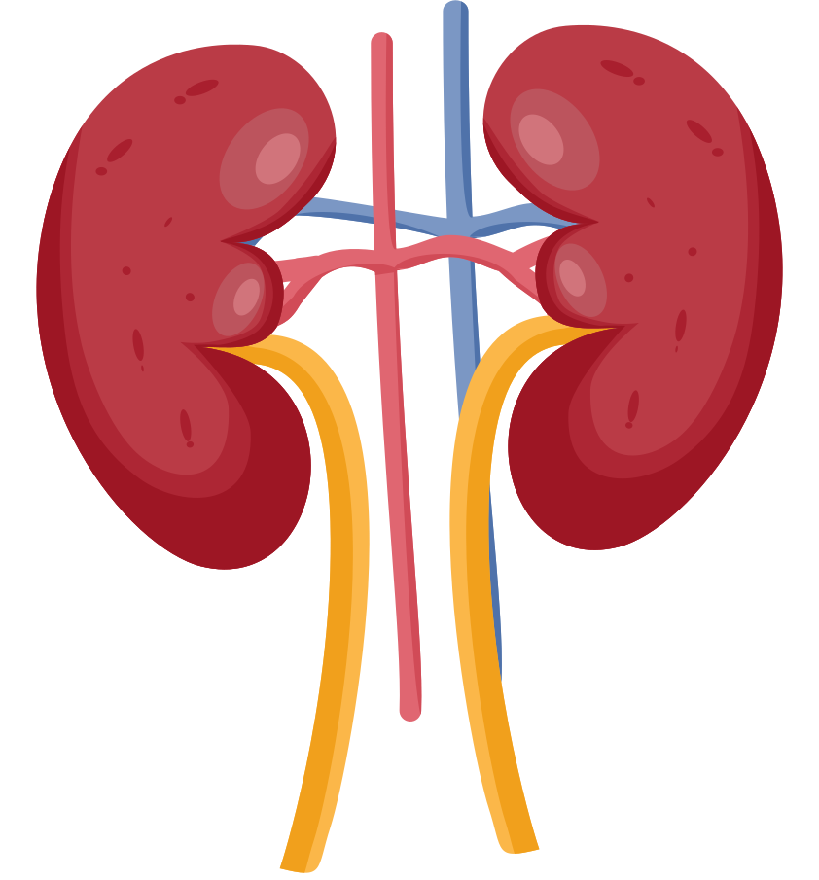
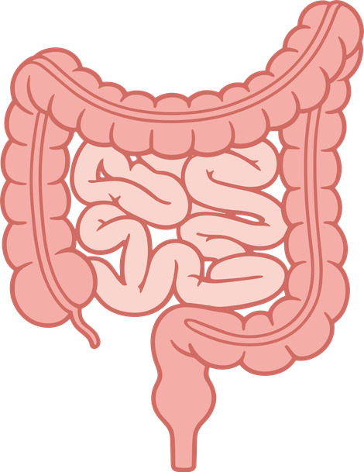
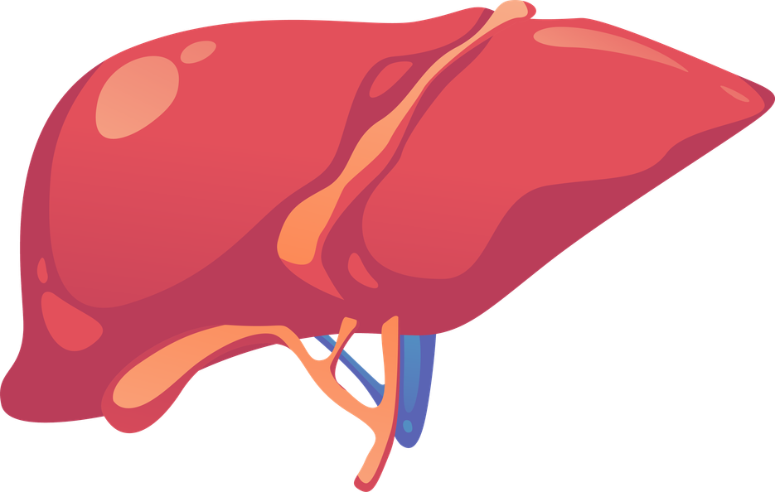

How does one organ donor save up to 8 lives?
There are 6 recoverable organs for transplant.
Can you guess them?
2 Lungs
2 Kidneys
Pancreas
Heart
Liver
Intestine
Notes:
How does one organ donor save up to 8 lives?
There are 6 recoverable organs for transplant. Can you guess them?
· Students raise hands or shout out guesses. Can also quickly brainstorm in pairs or groups before sharing.
· Reveal organs with one click and the name of each organ one by one on each *click*
· Heart, 2 lungs- can go to different people, liver, 2 kidneys – can go to different people, (small) intestines, pancreas
· Mention: because lungs and kidneys can potentially be split up, that is how you get the 8 lives saved!
**The kidney is in highest demand. About 86% of people on the waitlist are waiting for a kidney**

Slide 16

Notes:
This UNOS video gives a good overview of how the organ donation process works. It is 2 minutes and 33 seconds long. Click on picture to start.
*If video is not working in slideshow, go to pre-loaded video in different tab.
https://www.youtube.com/watch?v=gOGDlasUm0Q

Slide 17

Organ Donation Compatibility
Making the match
Notes:
Let’s take a closer look at how matching happens.

Slide 18
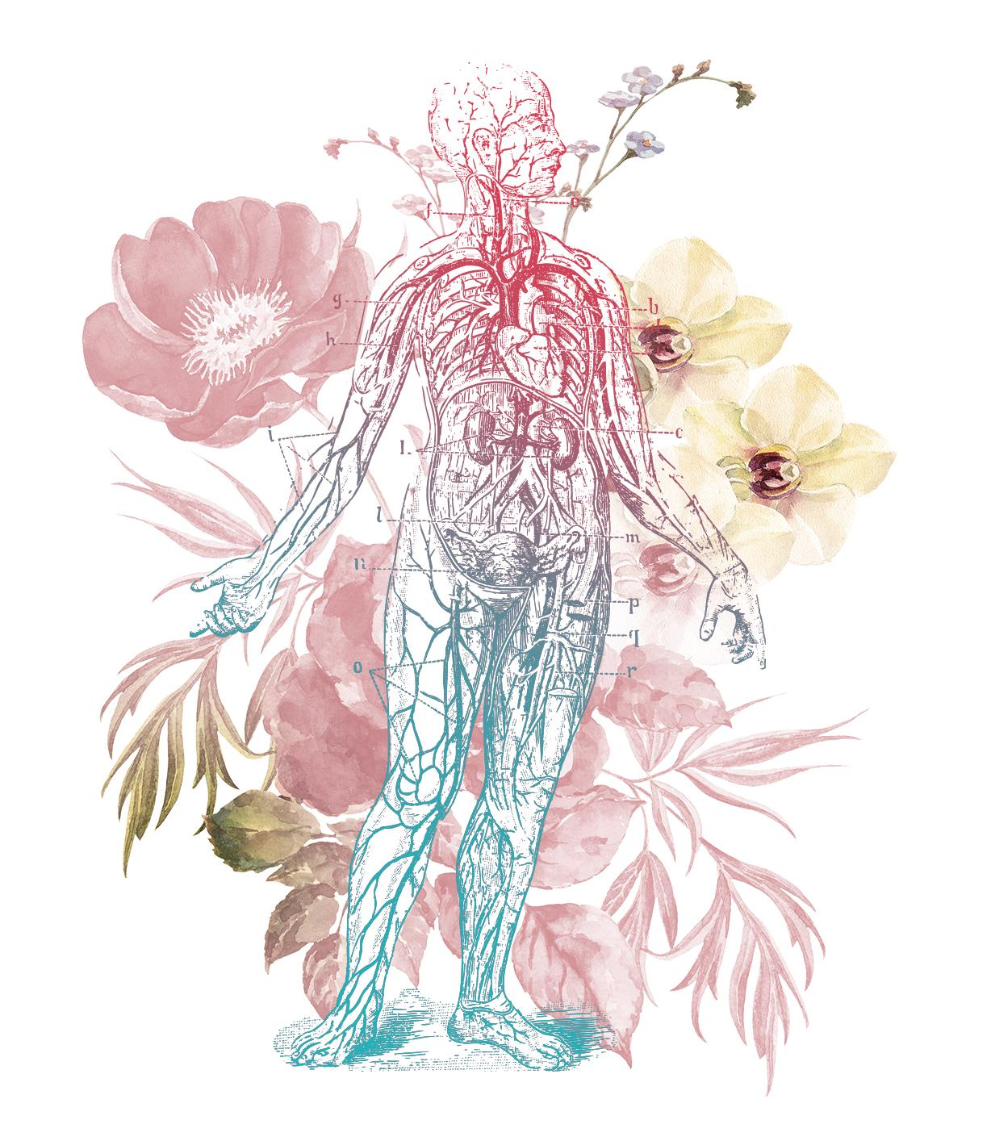
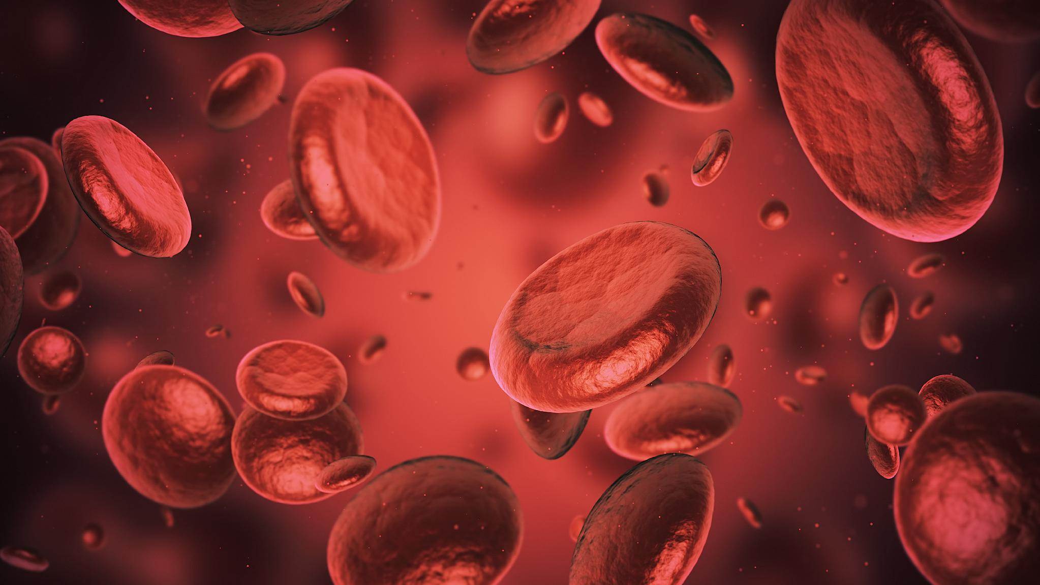
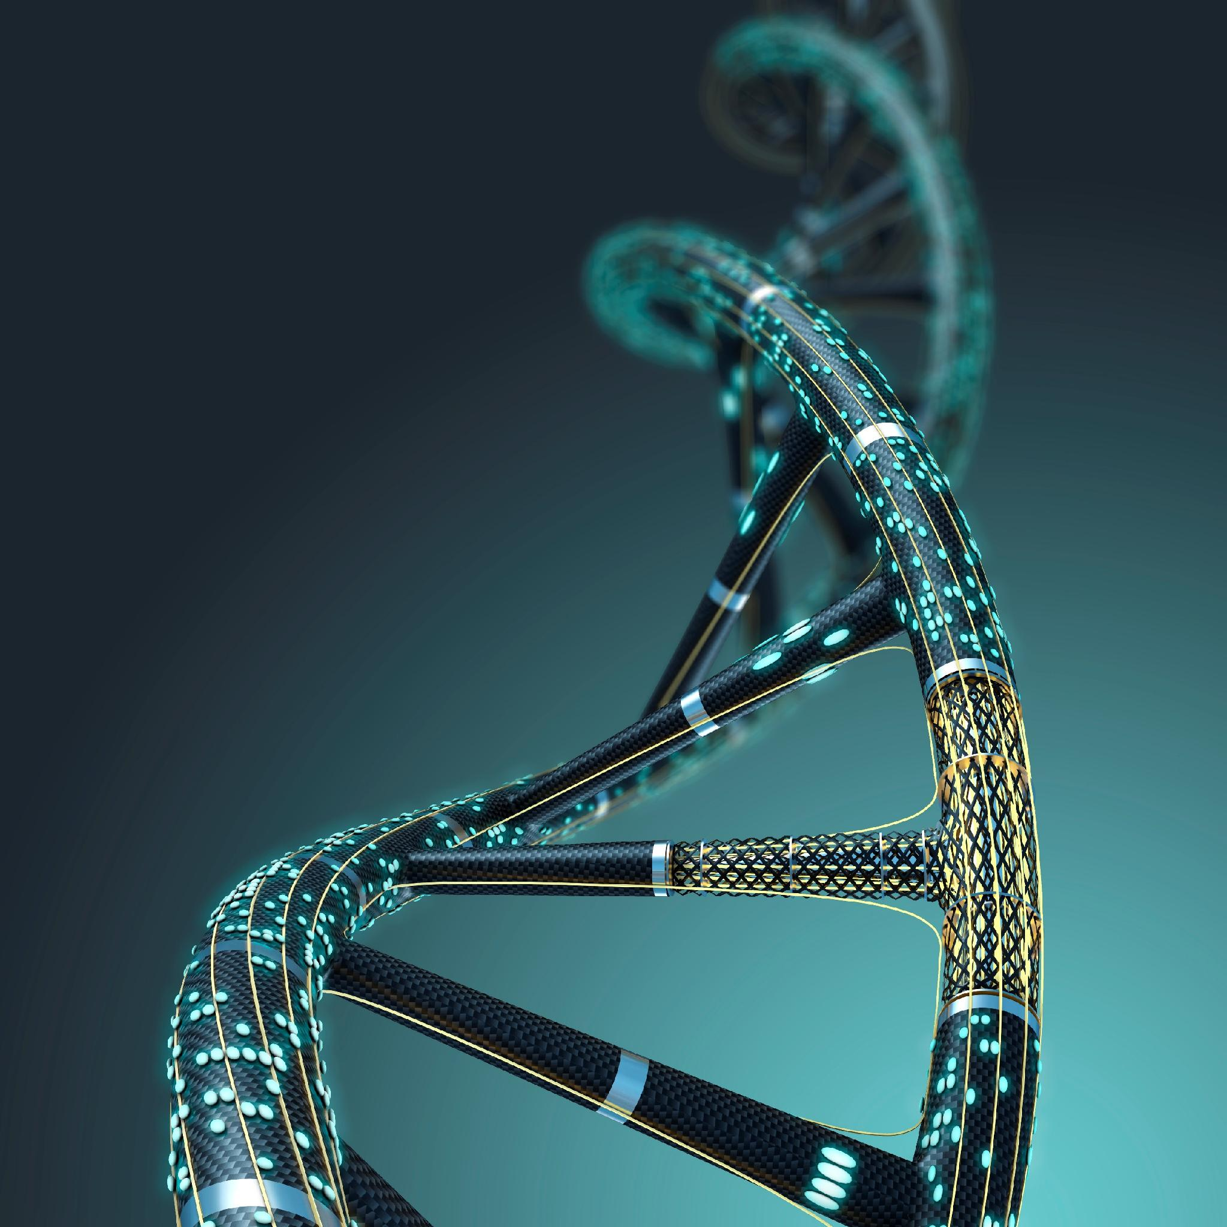
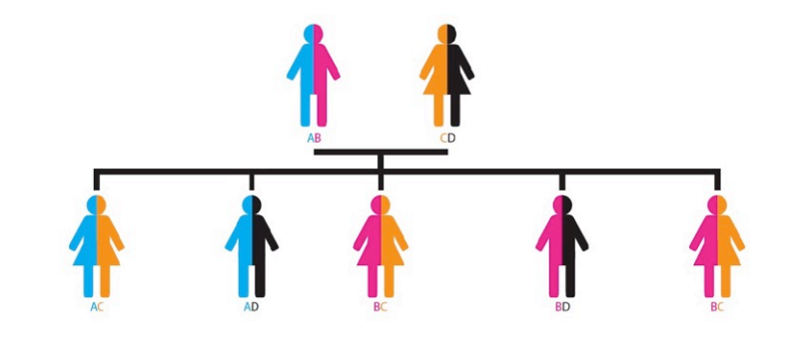
The Science of Self: What Makes You, You
We are all made up of inherited proteins, cells, genes and DNA.
We all have these in common, but they work together to make us unique individuals.
Some genes are expressed outwardly in features like hair and eye color.
Some are expressed internally in features we can’t see like blood type and tissue proteins.
These inherited proteins, called antigens, are markers on the surface of the blood and
tissue cells that identify you as “self” and play a crucial part in organ transplantation.
Notes:
On a cellular level we are all made up of the same things: proteins, cells, genes and DNA. Even though we have these in common, they work together to make us unique individuals.
Some of these genes express outwardly in things like eye and hair color, some express inside our bodies in things we can’t see like blood type and tissue proteins.
Some of these inherited proteins are called antigens. They are markers on the surface of the blood and tissue cells that identify your cells as “self” or belonging in your body.
The uniqueness of these cell surfaces plays a crucial part in matching organ donors and organ recipients for transplant.

Slide 19
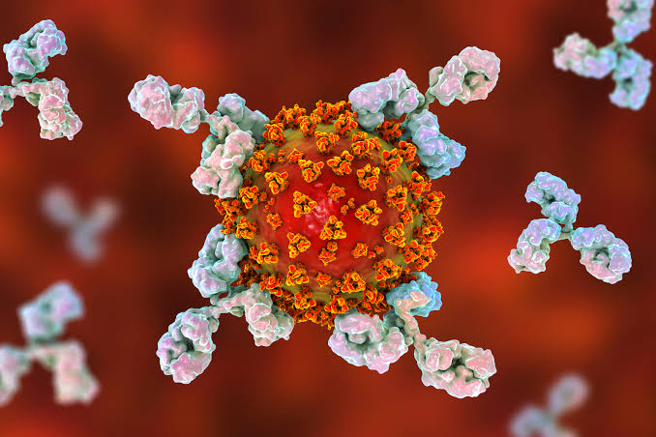
The Body’s Defense & Transplant Challenges
When “non-self” antigens are detected in our bodies antibodies are activated by our immune system to attack and destroy.
This keep our bodies healthy against bacteria and viruses but attacks a transplanted organ even if someone needs one to survive.
A successful transplant relies on many different factors of compatibility along with the recipient’s
lifelong management of immunosuppressant medication.
Notes:
When “non-self” antigens are detected in our bodies (e.g. from bacteria, a virus, and transplanted organs) antibodies are activated to attack.
Antibodies are small proteins that circulate in the body and are used by the immune system to identify and destroy foreign objects or things that are identified at “non-self”.
Antibodies are great in keeping the body healthy, but work against transplanted organs even if someone needs one to survive.
Placing a transplanted organ with mismatched antigens tells the antibodies to attack and kill this non-self invader. This leads to organ rejection. Even under compatible matches, recipients almost always need life long immunosuppressant drugs to combat organ rejection.
A successful organ transplant relies on many different factors of compatibility.

Slide 20
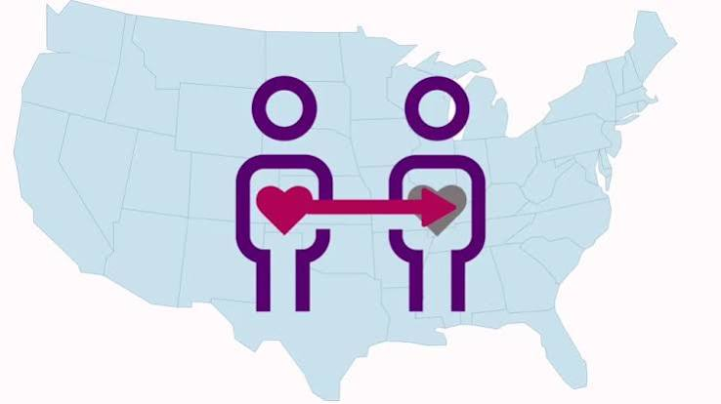
Matching
Matching an organ donor with a recipient depends on several factors:
Medical urgency
Body size
How long a person has
been on the waitlist
Blood type
Geography
Tissue type
Notes:
Matching an organ depends on several factors like how sick someone is, how long that person has been sick, how far away they are from the donor/transplant hospital, body size, blood type, and tissue type; some of these have more weight than others.
We know recipients are not matched based on race and ethnicity, but it is important to have as many people registered as possible because when we have a diverse pool of donors it increases the chance of someone finding their perfect match. Additionally, if people match and happen to be from the same racial/ethnic background, there is a higher chance for a successful transplant!
Geography is important because organs are only viable outside the body for a short time. (Perfusion technology being developed to increase time donate organs can remain viable for transplant). We’ll look at this in more detail in a few minutes.
For now we’ll focus more on these last two points.

Slide 21
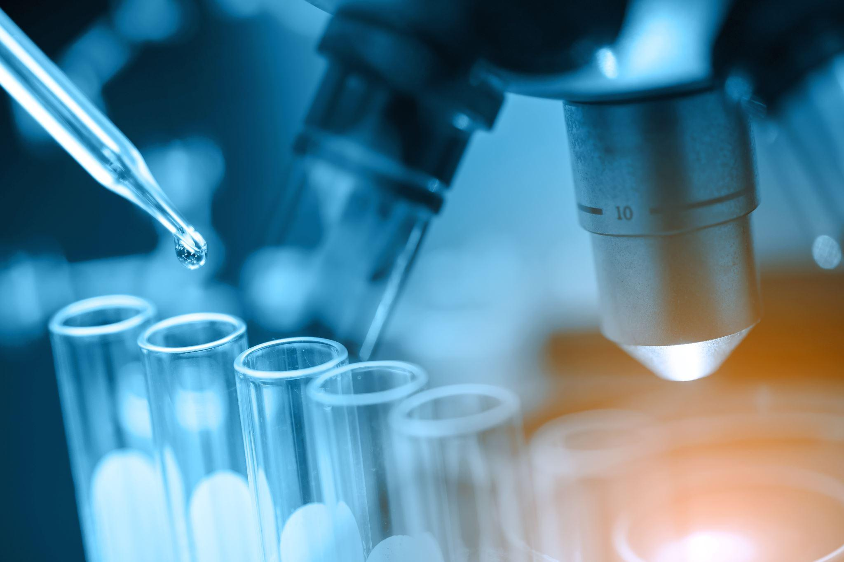
Testing Organ Compatibility
To successfully match organ donors with recipients, 3 crucial tests need to happen.
ABO Compatibility
(matching blood type)
Human Leukocyte Antigens or HLA
(matching tissue)
Cross Matching
Notes:
To successfully match an organ donor to an awaiting recipient, three crucial tests need to happen.
ABO Compatibility-matching blood type
HLA Human Leukocyte Antigens-matching tissue type and
Cross Matching- testing cells from the donor with blood from the recipient.
These tests are not only important for initial compatibility but can also indicate potential success/health or organ after transplant.

Slide 22
ABO Compatibility
What are the 4 blood types?
Organ Recipient Blood Type | Compatible Organ Donor Blood Type
O | O
A | A , O
B | B, O
AB | A, B, AB, O
A
Contains A antigens
AB
Contains both
A & B antigens
B
Contains B antigens
O
Contains neither
A or B antigens
Notes:
ABO Compatibility
Blood type MUST match for organ donation to happen and be successful. (Although there are some exceptions, some people with type A can donate to to people with type B when there is a low level of A antigens in the donor.)
RH (+ or -) does not matter in solid organ transplants, only in blood transfusions. Rh factors are not expressed in solid organs.
There are four blood types A, B, AB, and O
O is the most common at about 43.6% of the US population
A is the next common at about 42%
B is less common at about 10% of the US population
AB is the least common at about 4% of the US population.
Look at the chart to see what donor blood type is compatible for recipient blood type.

Slide 23
Human Leukocyte Antigens (HLA)
Biological parents
Each color represents
3 antigens
Biological children
Notes:
HLA is a genetic marker inherited from our parents that occurs on the surface of almost all cells in the body except red blood cells.
You are always a half match with your biological parent as you get 50% of your genetic make up from each. Only identical twins have identical HLA. (Since identical twins have matching genetic make up, if one twin is an organ donor to their identical twin, this often allows the recipient of the organ to avoid lifetime anti rejection medications. The immune system in the recipient doesn’t see the transplanted organ as an invader, but as self.)
For organ transplant 6 markers/antigens have been identified as most important for transplant and are tested for in both the donor and the recipient (There are 150 identified HLA markers in the human population.)
It’s not necessary to share HLA antigens, but studies have shown that some matching of these lead to longer lasting organ transplants. It is unusual for people who are not blood relatives to share more that one or two HLA antigens in common.
You can share 0, 3, or 6 antigens in common with a sibling.
Today an HLA match is less important than in the past as there have been many advancements in immunosuppressant drugs.
A transplant could even happen with a mismatch of HLA antigens as long as blood type and the cross match is compatible.

Slide 24

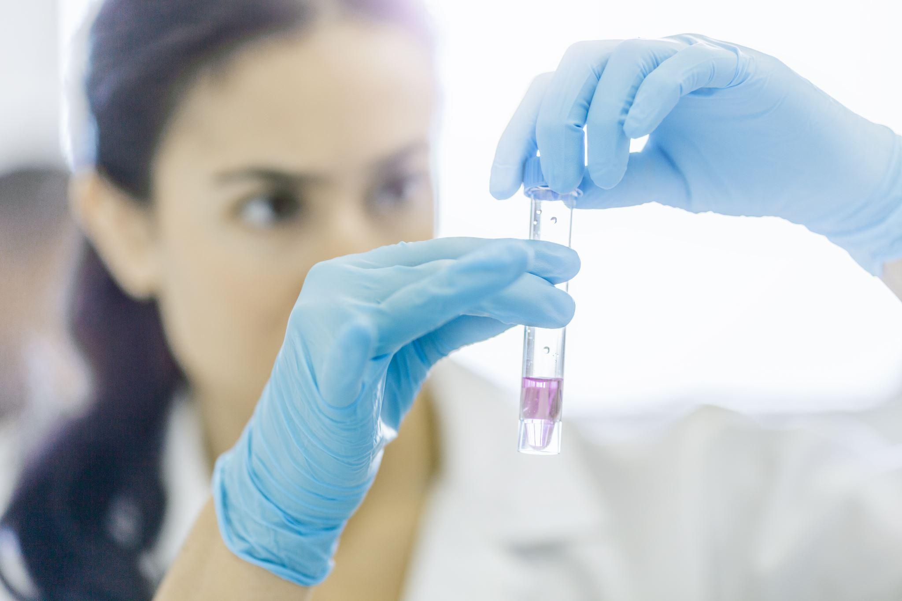
Cross Match
Cross matching happen when cells taken from the donor are mixed with serum from the recipient’s blood.
+ Positive Cross Match | Antibodies in the recipient are ready to attack | No transplant
- Negative Cross match | No reaction | Transplant happens
Notes:
The final test to determine if a donor organ can be safely transplanted is called a cross match.
Cross matching happens when cells taken from the donor are mixed with serum from the recipient's blood to show the transplant team if the recipient has existing antibodies against the potential donor.
Once we have been infected by a particular germ, our immune system remembers that antigen and identifies it as a germ so our antibodies can fight it if it returns in the future.
A similar reaction can happen if someone has been exposed to foreign tissue from a transfusion, pregnancy, or previous transplant.
Different people have different reactions to exposure. One person’s body could attack the antigen, could not attack it, or not attack it very successfully.

Slide 25
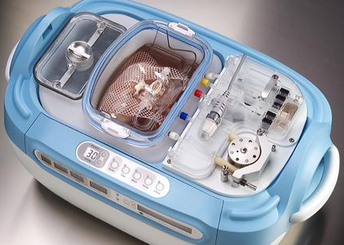
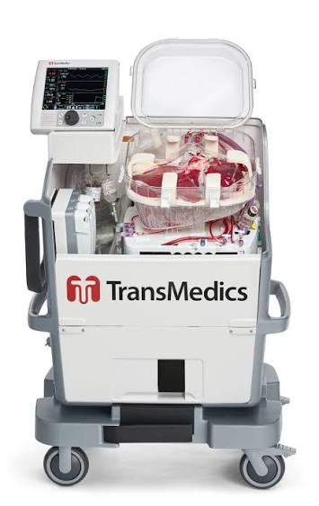
Organ Viability
Heart = 4 to 6 hours
Lungs = 4 to 6 hours
Liver = 8 to 12 hours
Intestines = 8 to 16 hours
Pancreas = 12 to 18 hours
Kidney = 24 to 36 hours
Cornea up to 18 hours
Tissue up to 24 hours
Machine perfusion
Notes:
Once a match is found the clock begins to get the recovered organ to the awaiting recipient. Organs are only viable or healthy for transplant for a very short amount of time.
To help aid in extending viability times machine perfusion is an area of continued research.
The most common types of perfusion used to preserve organ recovered from deceased donors are Hypothermic Machine Perfusion (HMP) and Normothermic Perfusion (NMP).
Hypothermic Machine Perfusion (HMP) in the first picture on the slide cools the organ below normal body temperature while pumping a oxygen rich solution. This slows down the organ’s needs and protects cells from injury during transport. It is manly used for abdominal organs like the kidneys, liver, and pancreas, but can be used for other organs.
Normothermic Perfusion (NMP) keeps organs at a normal body temperature (98.6 degrees F) with warm oxygenated blood to let organ function normally. This allows doctors to test performance of an organ and even repair damage prior to transplant. It is mainly used for hearts and livers but can be used for other organs. This is the second image on the slide.

Slide 26
Transplant is not a cure.
It is a treatment.
Notes:
When a person receives a transplant it is considered a treatment not a cure of the disease that is affecting their organ failure.
Along with this treatment is a lifelong need to take immunosuppressant drugs or anti-rejections medication, a dedication to a healthy lifestyle, and medical appointments and testing to make sure the recipient and the organ stay healthy, but the trade off is more life. More time with family and friends, more memories to share, and more time to achieve goals.

Slide 27
Name that Organ
The following slides contain graphic medical images of organs you’ve been warned!
Notes:
Give a warning about graphic images within the next 4 slides.
It’s time for Name that Diseased Organ! Pause after first click for students to guess.

Slide 28
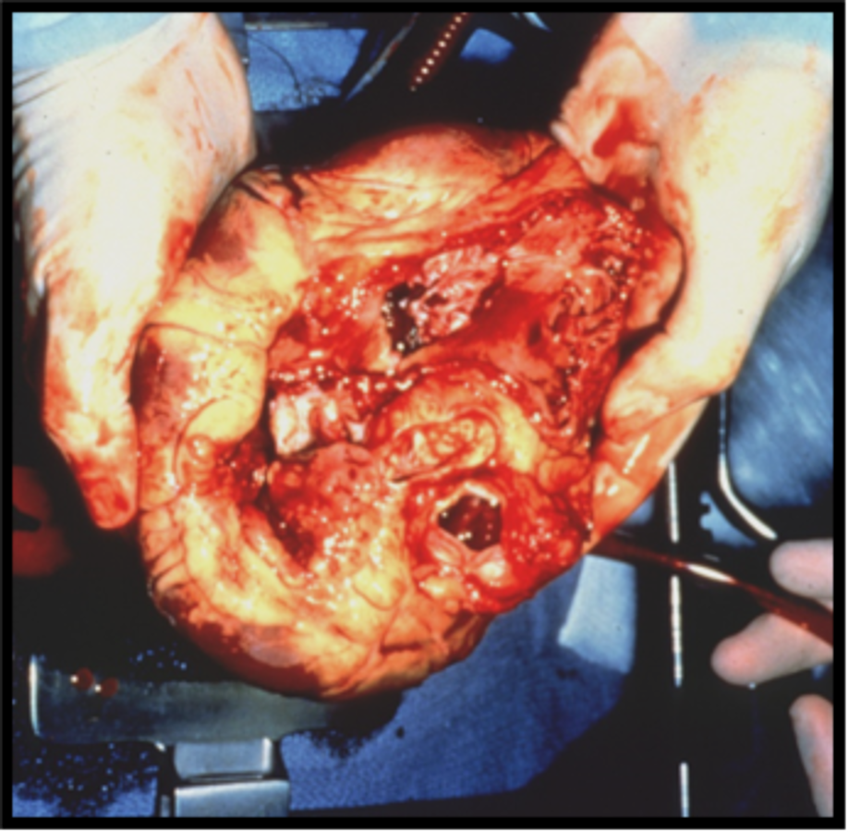
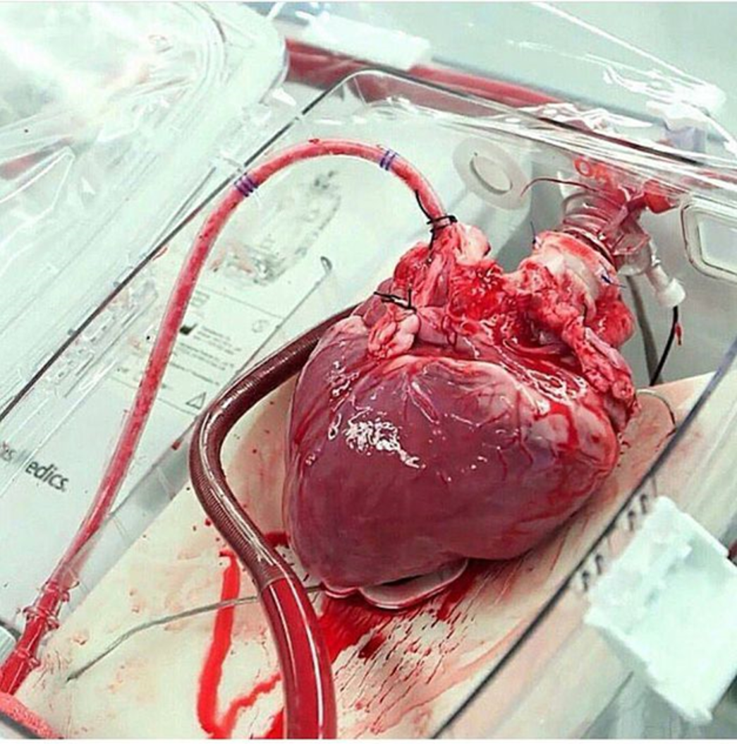
What organ is this?
Notes:
(Click) This first picture is of a diseased heart: Cardiomyopathy. Cardiomyopathy is a disease that can occur as a result of a virus, cancer treatments, hereditary causes, or unknown reasons. The heart grows larger and larger, and it becomes increasingly difficult for it to function adequately. People who suffer from cardiomyopathy can have shortness of breath, fatigue, swelling in legs, and irregular heartbeats. They can feel dizzy or lightheaded and faint or feel chest pain or pressure.
(Click) The picture on the right is of a healthy heart.

Slide 29
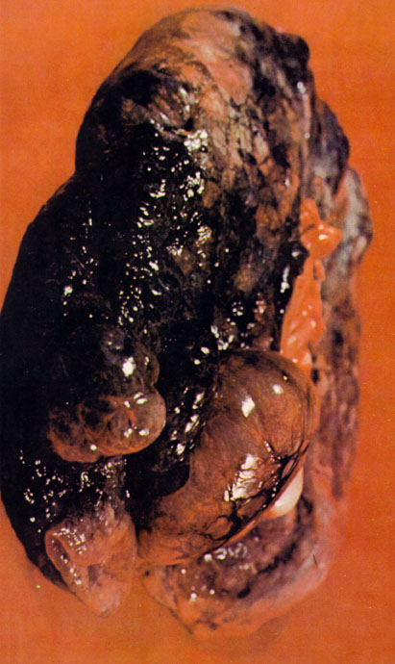
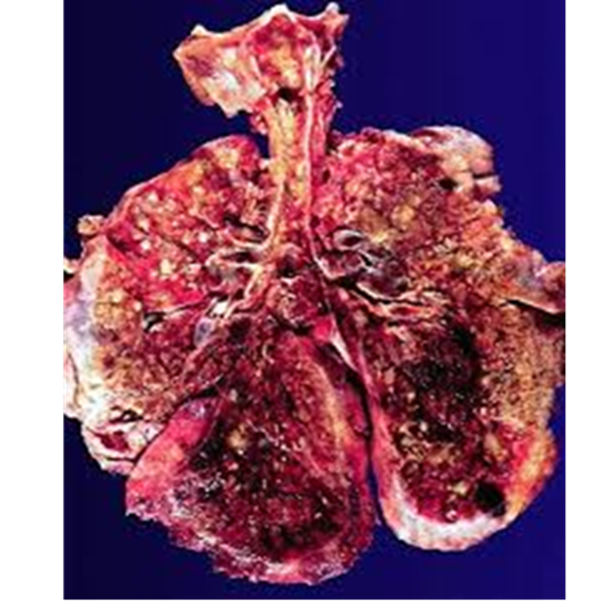
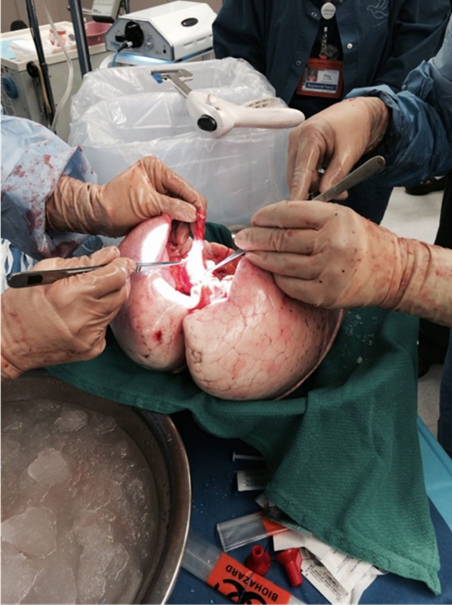
What organ is this?
Notes:
The first image is a lung with emphysema. The main cause is smoking, however there are also other diseases that may lead to emphysema. The second image is of a lung with cystic fibrosis. Cystic fibrosis in an inherited genetic disorder that causes the body to produce thick, sticky mucus.
When someone is in need of a lung transplant they are usually on oxygen 24 hrs/day and can’t walk more than a few feet without losing their breath. They also tend to have blue fingertips and toes because the oxygen needed to turn the blood red is in short supply and does not circulate properly.
The last image is of a healthy lung.

Slide 30
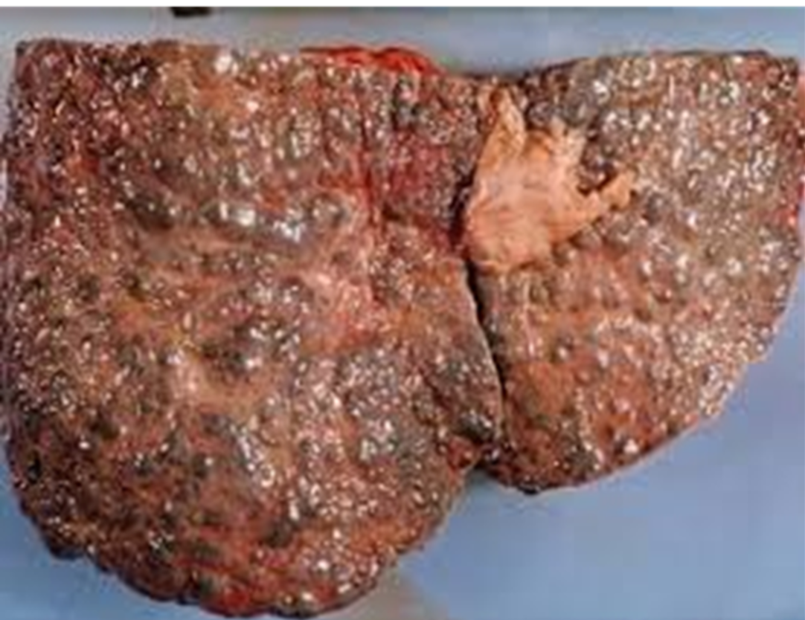
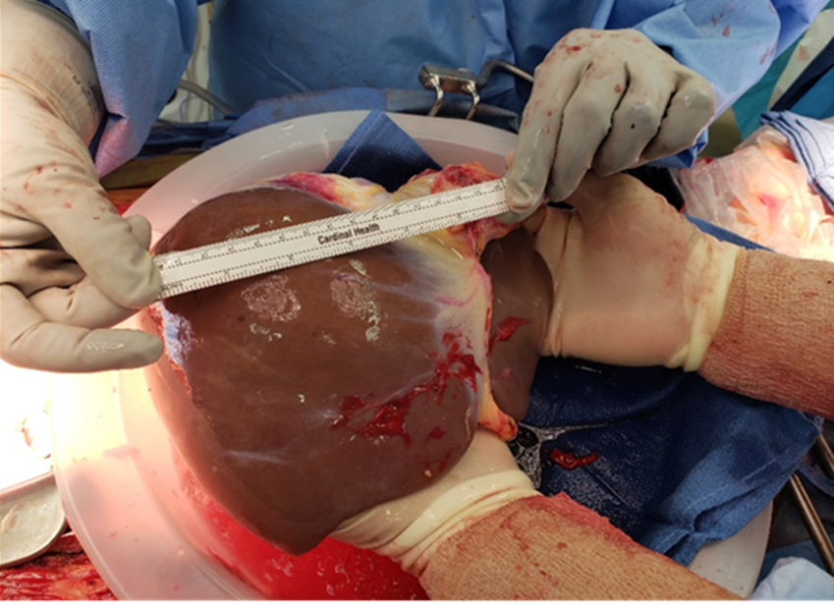
What organ is this?
Notes:
(Click) This is a diseased liver with cirrhosis. About 40% of those needed a liver transplant suffer from alcohol related cirrhosis. About 20% of liver transplant patients suffer from Hepatitis C and about another 20% suffer from MASH (formerly fatty liver disease”). **It is important to note that people who suffer from alcoholism must meet stringent requirements before they can ever be placed on the waiting list to receive a new liver.**
(Click) On the right we have a healthy liver. The liver is like a chemical factory that destroys toxic substances in the blood such as drugs and alcohol. It also processes nutrients and breaks down proteins, fats, carbohydrates and stores energy for later use.
People who are in liver failure may experience an accumulation of fluids in the belly and the extremities, Jaundice (which causes a yellowing of the skin and whites of the eyes as well as itching), and mental disorientation or confusion.

Slide 31
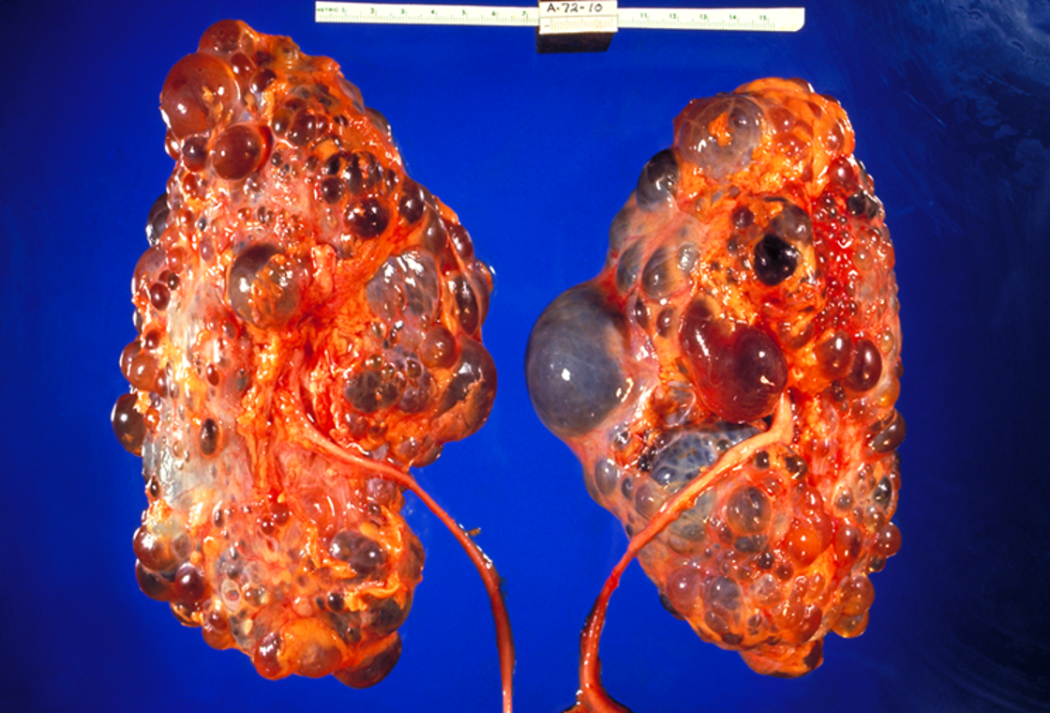
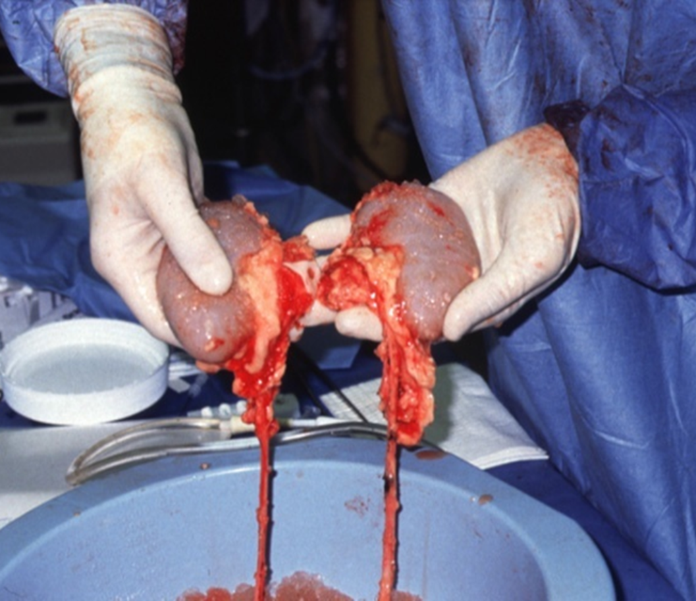
What organ is this?
Notes:
(Click) On the left we have two polycystic kidneys. This is an inherited condition that causes the kidneys to fail when many fluid filled sacs engorge the kidneys.
(Click) One the right we have a picture of healthy kidneys. The kidneys are responsible for filtering the blood. The kidneys are retrieved together and then separated for transplantation. Kidney donors can be the source of two transplants because humans only need one kidney to survive.
People suffering from kidney failure can experience swelling (edema) in their ankles, feet and hands due to the body holding excess fluid. They can feel fatigue, shortness of breath, and itchy skin due to the waste imbalances in the blood. They can experience muscle cramps, loss of appetite, nausea and vomiting, and experience changes in urination.

Slide 32
Cornea & Tissue Donation & Transplantation
Notes:
Let’s focus more now on cornea and tissue donation and transplant.

Slide 33

One tissue and eye donor
can save or enhance over 125 lives.
Notes:
Reminder: 1 organ donor can save up to 8 lives, 1 eye/tissue donor can save/enhance up to 125 lives!
Why is it so much more? Have students brainstorm and share why they think so.
This number is an average for the Pacific Northwest. One eye donor can save or enhance up to 2 lives, while one tissue donor can save or enhance an average of 125 lives. The actual number could be less or more.
Nationally the average is 75.
Solvita works closely with the potential donor’s next-of-kin and doctors to do a thorough evaluation. A full medical and social history is conducted (several times in fact) to ensure that the donor’s tissues are safe for transplant.
Once tissue is recovered, it can be preserved and stored for up to 5 years (Cornea for 3 years). It can be transported to recipients in our local area, around the US, or even internationally. There is no waitlist for cornea and tissue.

Slide 34
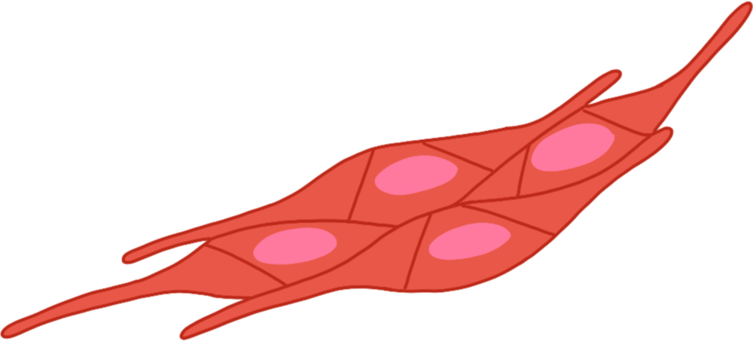

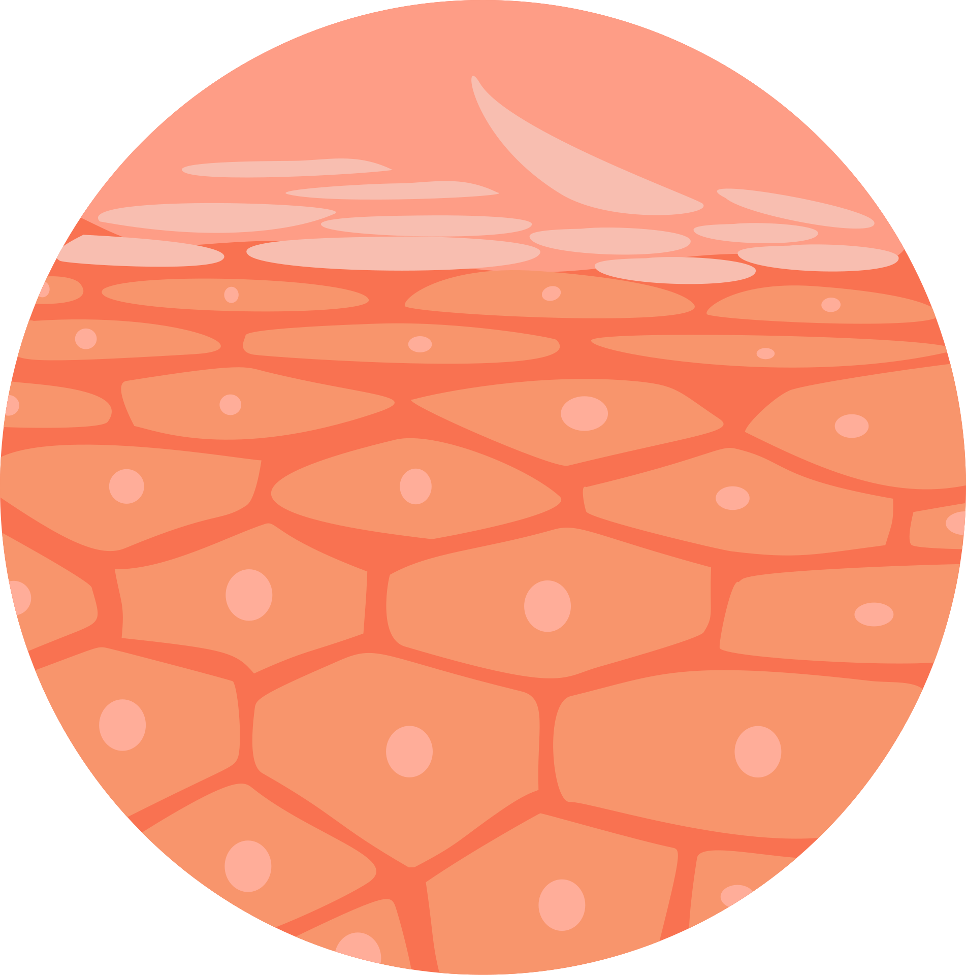
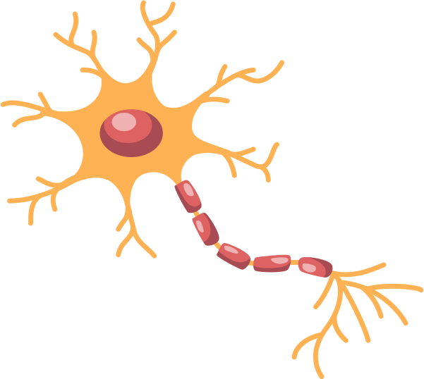

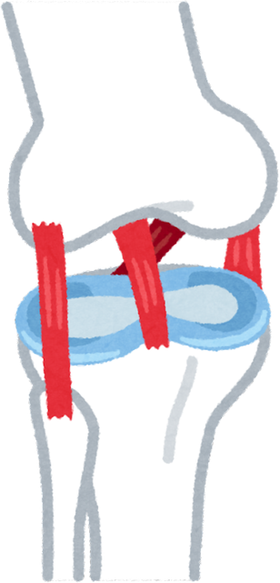
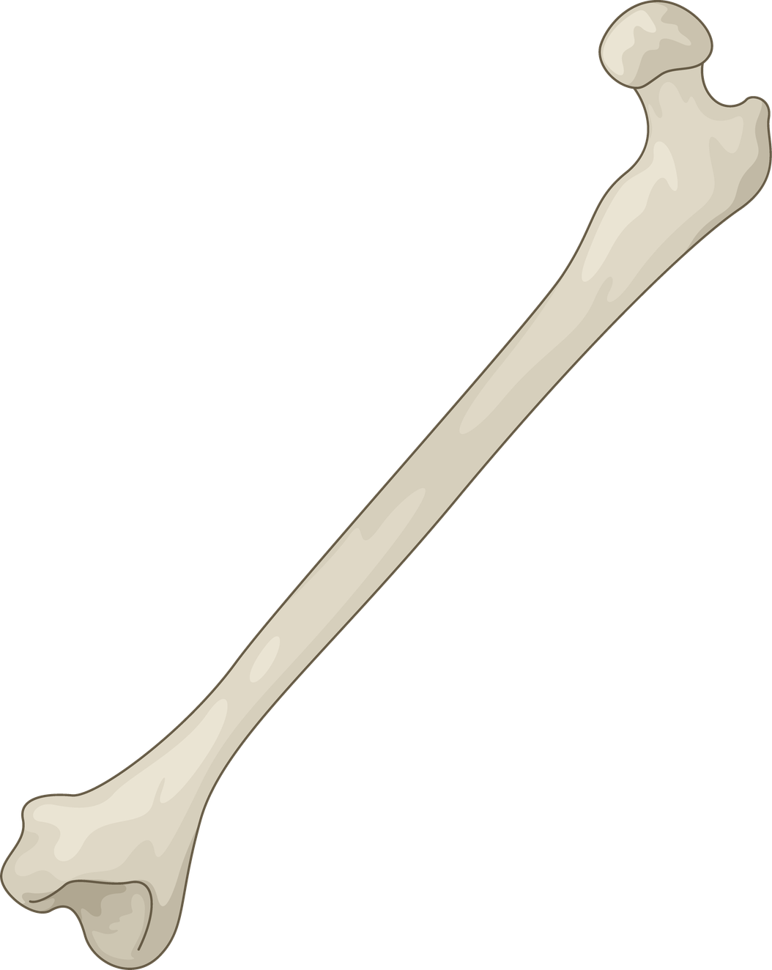
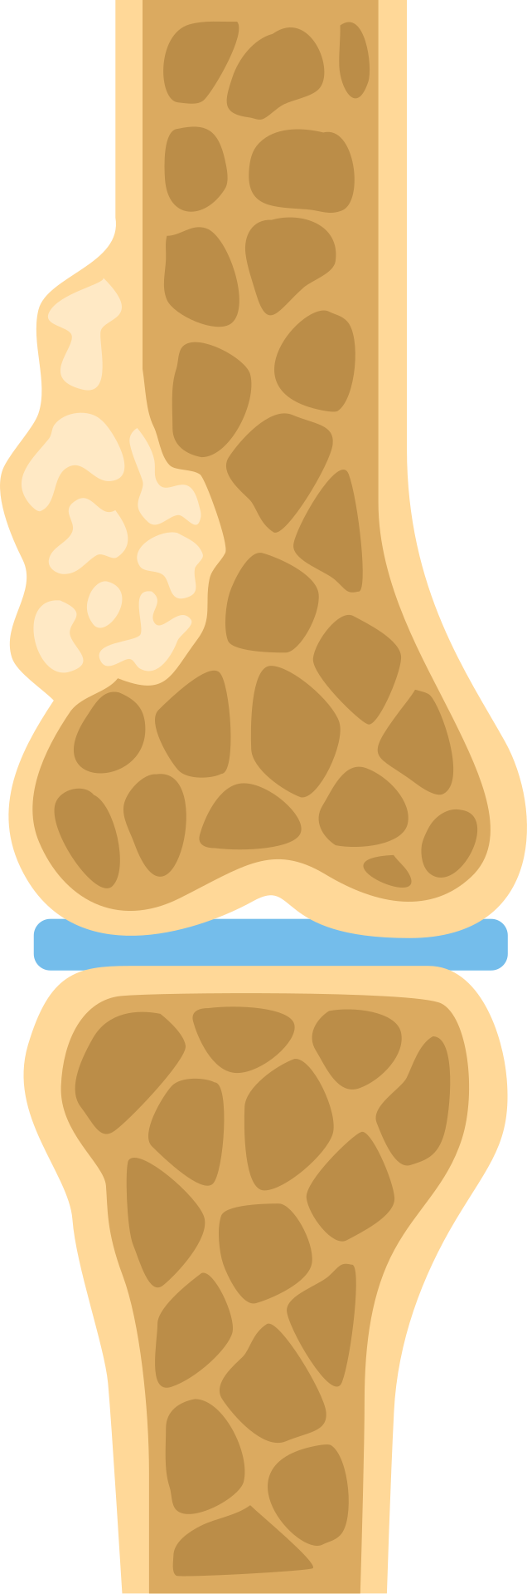
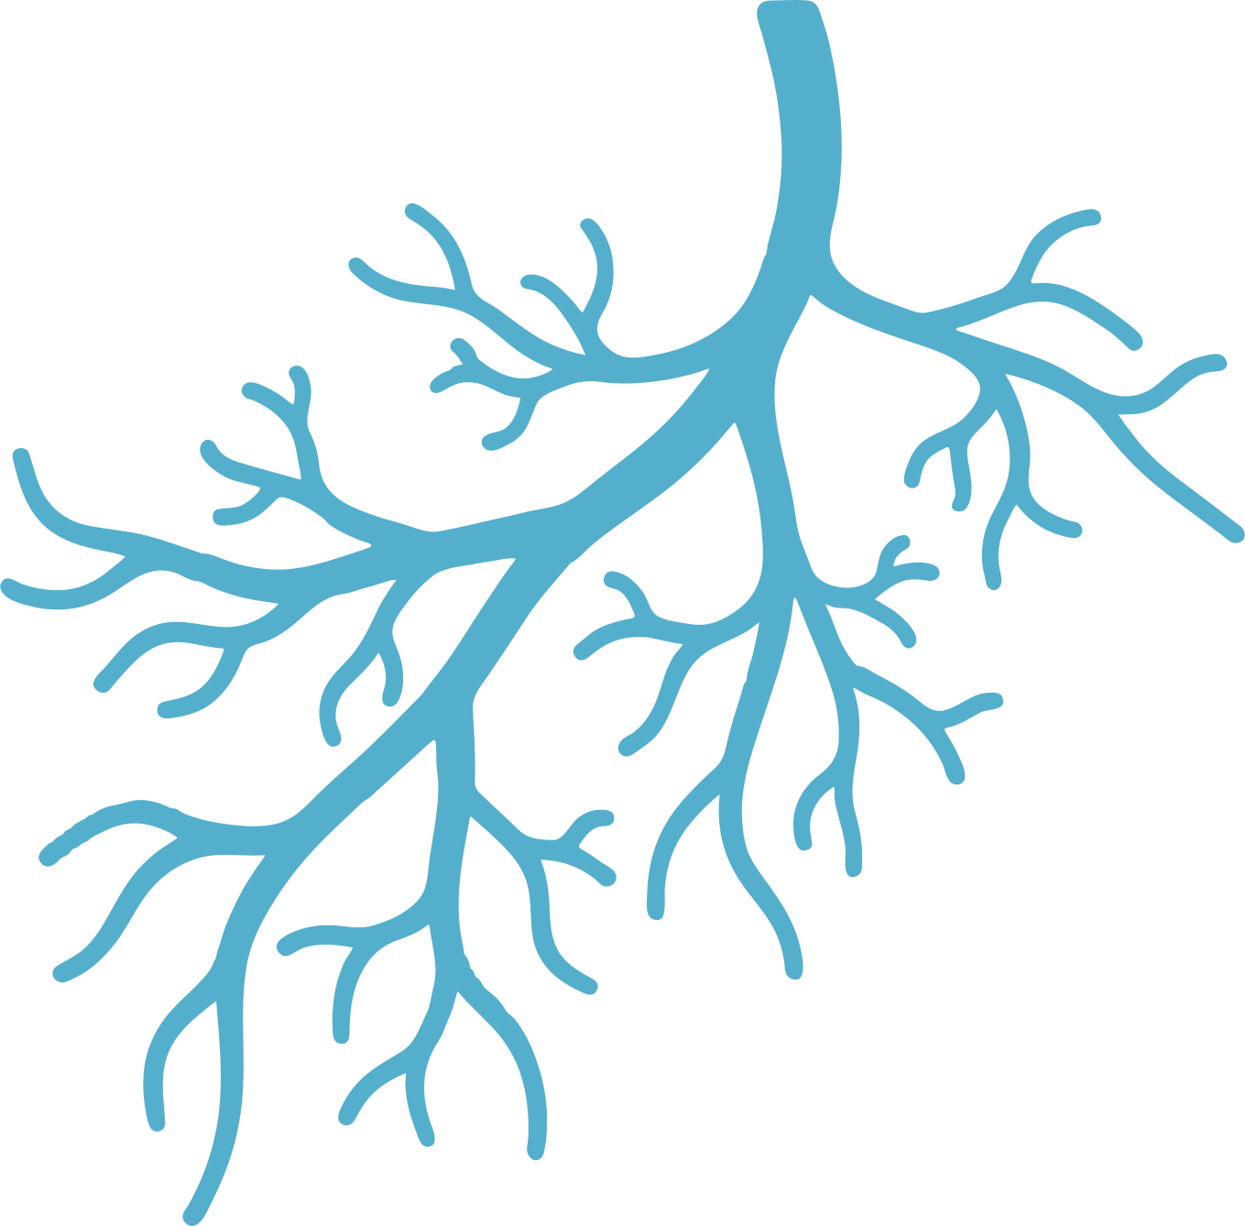
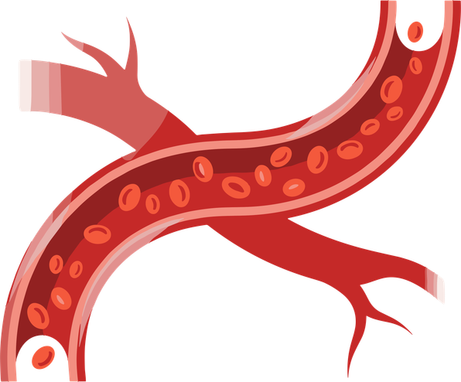
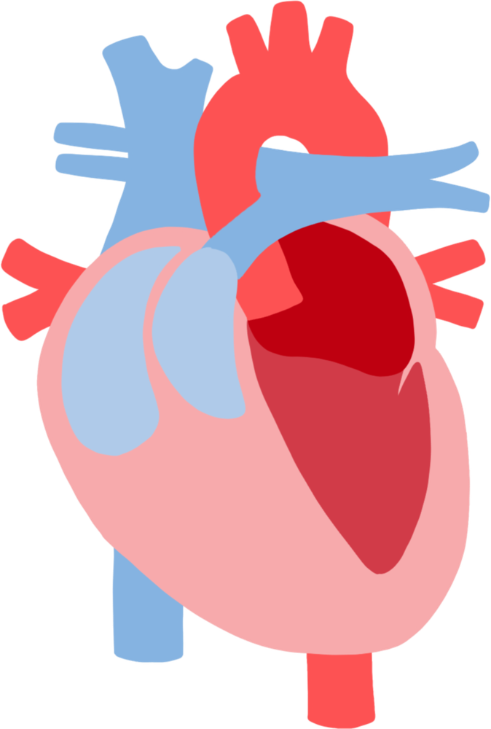
connective tissue
cornea/sclera
skin
What types of tissue can be donated?
tendons
nerves
bone
ligaments
cartilage
arteries/veins
heart valves
Notes:
What kinds of tissue can be donated?
(connective tissue, corneas/sclera, skin, nerves, tendons, bone, ligaments, arteries, veins, heart valves, cartilage)
Ligaments and tendons may be used for reconstruction of rotator cuff, knee ligaments, and Achilles Tendon repair. Ligaments and tendons also don’t have to be one for one transplants. For example, an ACL can replace other ligaments in the body
Cartilage (also pictured) can be donated and used to help repair joints for people with arthritis. Cartilage does not repair itself like bone, what we are born with is all we have.
Veins/Arteries: repair of veins and arteries to improve circulation if there is disease, injury, or blockage
Nerves: Provides a pathway for nerves to reconnect due to injury or surgery. Restores peripheral nerve, muscle, and organ function. Restores sensory feeling!
Skin: donated skin (taken unobtrusively from a donor, only the thickness of a piece of paper) is used as a biological bandage primarily for burn patients, but also can be used for slow or non-healing wounds like diabetic ulcers. Donated skin prevents infection and allows patients to heal until their own skin can grow back. Donated skin is removed from areas usually hidden by clothing (back, back/front of legs, buttocks, and tops of thighs; sometimes the front of the trunk and the back of the arms). Donation of the skin does NOT interfere with funeral viewing arrangements.
These are just a sample of what type of tissue can be recovered. The list of bone, cardiovascular (valves, arteries, and aorta tissue), skin, tendons, connective tissue, ligaments, nerves, as well as fresh allografts is quite extensive and available on the next slide.
Nationally, more than 2.5 million tissue transplants heal lives each year. In 2023 Solvita distributed 22,079 square feet of skin.

Slide 35
Extended list of recoverable tissue
Nerves
  Deep Peroneal Nerve
  Tibial Nerve
  Sciatic Nerve
  Musculocutaneous Nerve
  Median Nerve
  AIN (Anterior Interosseous)
  PIN (Posterior Interosseous)
  Ulnar Nerve
  Radial Nerve
  Femoral Nerve bundle & branches
  Superficial Peroneal Nerve
  Common Peroneal Nerve
  Sural Nerve
  Lateral Sural Nerve
  Plantar Nerve
Bone
  Proximal/ Distal Femur
  Whole Femur
  Proximal/ Distal Tibia
  Whole Tibia
  Proximal/ Distal Fibula
  Hemi-Pelvis
  Humerus
  Radius
  Ulna
  Costal Cartilage w/ Sternum
Cardiovascular Heart
  Valves (tricuspid, bicuspid)
  Aorta
  Pulmonary Valves
  Descending Thoracic Aorta
  Saphenous Vein
  Femoral Vein/ Artery
  Aortoiliac Artery
Connective Tissue
  Fascia
  Pericardium
  Ligaments
    Patellar Tendon w/ Ligament
Tendons
  Achilles
  Semitendinosus
  Anterior Tibialis
  Posterior Tibialis
  Peroneus Longus
  Plantaris
  Achilles
  Semitendinosus
  Gracilis
Fresh Allografts
  Knee Block
  Ankle Block
  Arm Block
  Shoulder Block
  Elbow Block
  Bilateral Cartilage
Skin
Full-thickness
  Split-thickness
Notes:
ADVANCED VERSION Information courtesy of Solvita, 2023.

Slide 36
IMAGE WARNING
The following images are of a eyes and tissue. You do not have to look.
Notes:
Image Warning.
These next slides will show skin, eyes, and blood and stitches.
You don’t have to look, now is your chance to look away.
*pause briefly

Slide 37
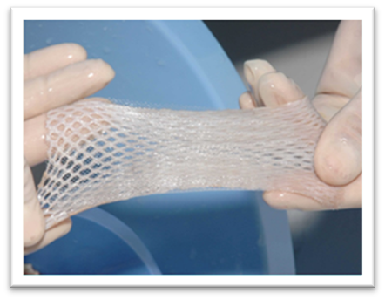
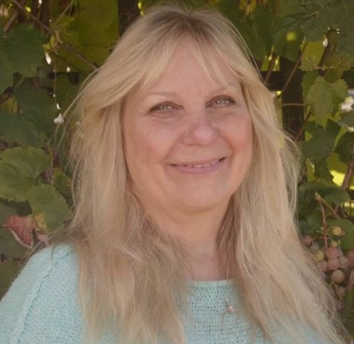
Life Saving Skin
Jan’s Story
  Saves the lives of people with severe burns
  Graft placed over the wound
  Prevents infection, regulates body temperature, replaces/repairs lost skin
Notes:
The impact of skin grafts (picture of real, donated skin)
· Typically used to heal severe burn victims
· The graft and place it over the wound
· Shaped like a thin sheet with holes to allow oxygen to reach the injury. Skin grafts help prevent infection, regulate body temperature, and replace/repair lost skin.
Jan’s story 1 minute 30 seconds. Click on link above Jan’s picture. If link does not work try the link below.
https://www.youtube.com/watch?v=JmdFF5TikI8

Slide 38
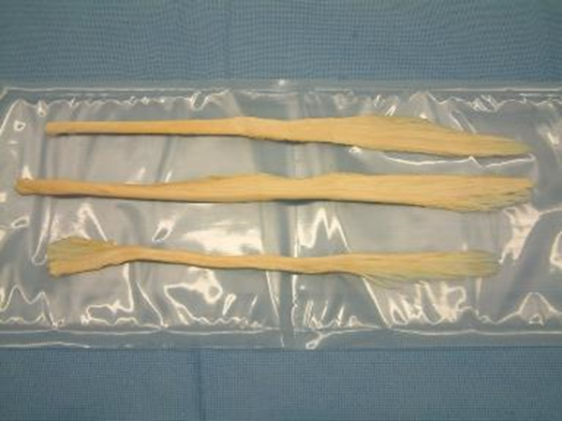
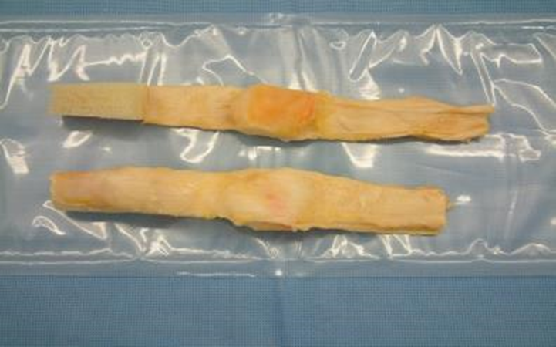
THE IMPACT OF TENDON & LIGAMENT REPAIRS
  Common: tearing an Achilles Tendon or ACL
  Athletes are susceptible but can happen to anyone!
  Transplant may be the only option for a full recovery
  Restores mobility, eases pain, scaffolds healing
Tendons
(muscle-to-bone)
Ligaments
(bone-to-bone)
Notes:
Keep. The impact of tendon and ligament repairs:
Achilles tendon or ACL tears are common. You may hear about them among athletes, or you may know someone who has personally tore a tendon or ligament.
Many individuals may need a transplant to get back to peak performance, sometimes it is their only option for a full recovery.
Something cool about tendon/ligament repairs is that they are so versatile. They do not have to replace the same body part one-for-one. For example, a recovered Achilles tendon can repair someone else’s Achilles tendon, BUT it can also repair other tendons in the body. So, the transplanted tissue does not have to be from the exact same body part as the injury. (However, still must be the same type of tissue. Tendon cannot repair a ligament).
Tendon/ligament transplants can restore mobility, ease pain, and scaffold healing

Slide 39
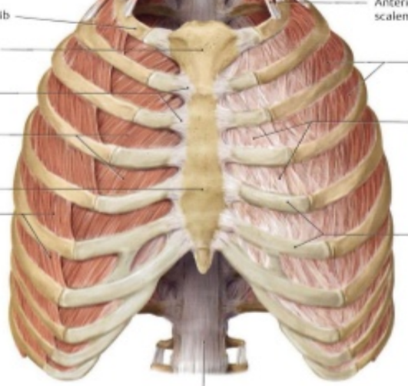
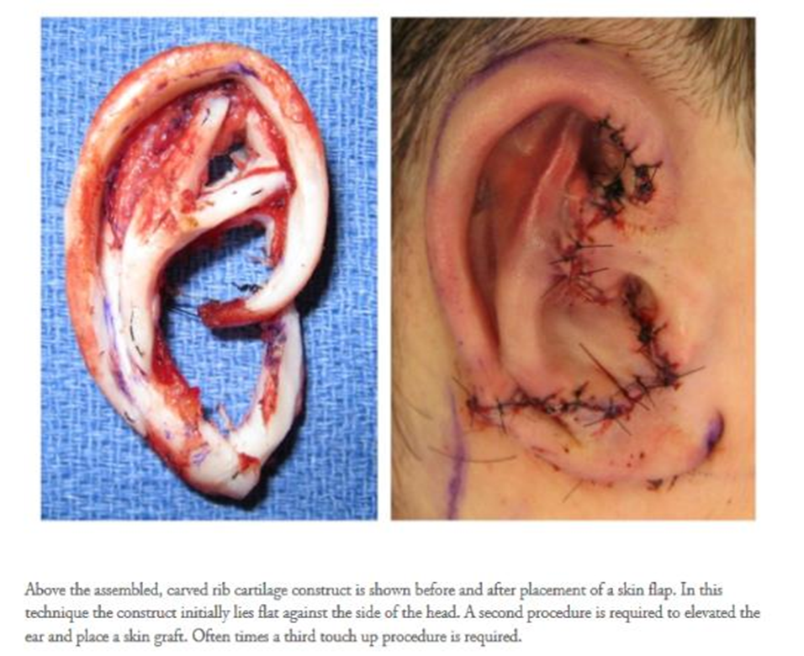

Rib Cartilage ⟶ Outer Ear Structure
Notes:
Rib cartilage to an outer ear reconstruction
This shows how a donor’s rib cartilage can be recovered and reconstructed into an outer ear structure.
Outer ear provides protection, improves/amplifies hearing, prevents dust and debris from getting into ear canal, and structure to support garments such as glasses/sunglasses/masks/air pods/etc.
Received from Solvita, 2024.

Slide 40
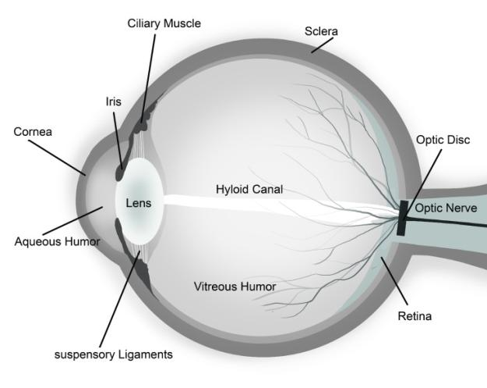
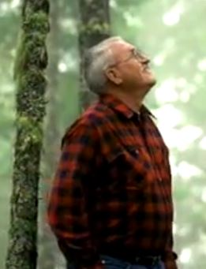
What is the cornea?
John’s Story
Notes:
Corneal transplant is the most common of all transplants performed! In fact, more than 78,000 corneal transplants take place each year in the United States.
The cornea is the clear surface at the front of the eye. It is the main focusing element of the eye, containing six microscopically thin layers. It protects the eye from dust, and germs, and is responsible for vision focus (it is not the colorful iris nor the black pupil). Heredity conditions, eye injury, and disease or infection can be reasons that people might need a cornea transplant.
Optional: “John’s Story” video is 53 seconds long. Click on the link by his picture to show video. If it doesn’t play try this link:
https://www.youtube.com/watch?v=a0RknpbZ9MU&list=PLP5wlax1nQ_D4c8bD89U24yvsMKu53c4L

Slide 41






The Impact Of Cornea Transplant
Transplant Procedure
Chemical Burn
Keratoconus
Vision with Fuchs Dystrophy, untreated and post-transplant Vision in the same patient.
JAMA Ophthalmol. 2015;133(4):e145353.
Notes:
Why might someone need a corneal transplant?
Hereditary conditions. Certain medical conditions make the cornea very thin or cloudy or cause other problems that can only be treated by replacing the cornea. Examples: Fuchs dystrophy, corneal dystrophy, and glaucoma.
Injury to the eye. For example, chemical burns or exposure; and corneal abrasions.
Disease or infection. With keratoconus, for example, the shape of the cornea slowly changes from the normal round shape to a cone. Steph Curry from the Golden State Warriors suffers from keratoconus and is currently being treated by wearing specialized contacts called scleral contact lenses. They vault over the entire corneal surface including the white part of the eye, creating a smooth optical surface to correct vision.

Slide 42






What can you donate while living?
A kidney, a portion of your liver, or a small lobe of the lung.
Most people are familiar with donating blood or bone marrow
Generally, must be at least 21 years old to participate.
Not the same as deceased organ donation, has nothing to do with the donor registry or registering at the DMV or online.
Notes:
Please note that this presentation is designed for a high school audience. The goal is simply to raise awareness of LKD, not promote it. Most high school students are too young to be considered a living donor. Most transplant hospitals was living donors to be 21 before making the decision.
If you’d like to learn more about living kidney donation, see the Recycle Yourself: A Guide to Organ, Eye and Tissue Donation curriculum.
In 2025, about 15% of the organs transplanted came from living donors.
Pictured top is Cam Dixon, a former Portland State University soccer player who donated a portion of her liver to her mom, Jamie Ellman, in 2023. Cam’s Op Ed in the NCAA News: https://www.ncaa.com/news/soccer-women/article/2023-12-15/op-ed-portland-states-cameron-dixon-sacrifices-senior-season-save-moms-life
Pictured below is Gloria Little, a kidney recipient, and living donor, Allison Wiley. While Gloria and Allison weren’t a compatible match for direct donation, through paired donation Allison was able to donate her kidney to someone in need. This in turn moved Gloria up on the waiting list. Gloria’s Story of Hope:
https://www.donatelifenw.org/stories-of-hope/gloria-little
In 2025, Jesse Eisenberg, a notable actor, donated a kidney altruistically to a stranger.

Slide 43


Donor Families
The gift of more life is invaluable to those who receive a donated organ or tissue, and donor families, like Hayden’s, are also impacted by the gift their loved one has given to others.
Notes:
Through Their Eyes: Hayden’s Legacy: Video 3:38 minutes (provided by VisionGift). Click on Hayden’s name to play the video.
https://www.youtube.com/watch?v=7wFW_Bf66Ks
2022 DLNW Dia de Muertos altar honoring those who gave the gift of hope to others through donation and their families.

Slide 44
How can I register to be a donor?
You can register:
  at the DMV
  online at our website www.gorecycleyourself.com
  through the iPhone health app when you are 18.
Notes:
You can register:
o DMV (when you get your permit, license, or ID)
o iPhone Health App (when you are 18)
o Online
There are NO limitations to signing up (anyone can register regardless of health status, physical ability, gender identity, sexual orientation, etc.) except you need to be at least 13 years old in Oregon to declare your intent to be a donor(age of medical consent in Oregon) or 15.5 in Washington. It is determined by a doctor at the time someone passes away if they can be a donor or not.
The iPhone Health App registers you on the National Registry (meaning no matter what state you live in, you are a registered organ donor), but you do need to be at least 18 years old to sign up on the National Registry
Register Online at www.donatelifenw.org/content/register-now.

Slide 45
Talk to with your family.
Although you can register your intent online at 13 in Oregon and 15.5 in Washington, your next of kin has the final say on organ, eye, and tissue donation until you are 18.
Notes:
Let students know this can be a hard conversation to have, but it is important. Taking a DLNW brochure home and leaving it where the people you live with can see it and ask about it is a great way to get the conversation started.

Slide 46
WHY PEOPLE SAY “NO” TO DONATION
Can you guess?
?
?
?
?
?
?
Notes:
Although many people in our region often register, the reality is, not every says “yes” to organ donation. And that’s ok. But why is that?
At Donate Life Northwest, we hear a lot of interesting reasons… and sadly, most are based in fears, myths, and incorrect information! Ask students, What do you think those reasons might be? Have them share with the group or share as a small group before coming back to the larger group. It is very common for people to believe what they see in movies or on TV.
*Click through each bullet point and discuss as you go.

Slide 47
WHY PEOPLE SAY “NO” TO DONATION
WHY PEOPLE SAY “NO” TO DONATION
Inaccurate tv/media portrayal
Compromised medical care
Religious beliefs
Illegal organ trade
Worry of additional cost
Funeral arrangements
Don’t think they are eligible
Notes:
There are various reasons why people may opt out of organ donation. A lot of them are valid, however many are rooted in misinformation. Let’s go over some of these answers and talk about why these common myths are inaccurate.
· Compromised medical care
o Myth: The doctor will let me die if they know I am a registered organ donor, they just want my organs.
o Fact: In an emergency, the doctors’ #1 priority is to save your life. They went into the field for a reason; they took an oath. Also, the medical team and organ donation team are completely separate. The doctor does not know your donation status or have access to the donor registry.
· Religious beliefs
o Myth: My religion does not support organ donation.
o Fact: All major religions support organ donation, however if you are unsure, please talk to your spiritual/faith leader. Even if you think the answer is no, you might be surprised!
Inaccurate tv/media portrayals of donation and transplant
Myth: What I see on tv and in media must be true.
Fact: TV and media often have inaccurate portrayals of donation and transplant for entertainment value or only give part of the information. Always consider your source.
· Illegal organ trade
o Myth: There is a corrupt system in the US where organs will be sold for money
o Fact: It is illegal to sell human organs in the United States, and the organ donation system is heavily regulated by the government with multiple safeguards in place. The OPO carefully tracks and reports organs recovered under strict metrics that must be met to remain operational.
· Worry of additional cost
o Myth: Organ donation is extremely expensive.
o Fact: Organ donation is completely free for the donor's family. It is a selfless gift. However, all life-saving efforts by the hospital prior to the donation/recovery process do cost money (ex: procedures, scans, medication, hospital stay, etc.)
Funeral arrangement
Myth: I can’t have an open casket or viewing if I am an organ donor. I can’t be cremated if I am an organ donor.
Fact: All these final wishes can happen along with organ donation. Recovery is done in a respectful way. Recovered organs and tissue are replaced with prosthetics and all incisions are closed. Skin is taken from the backside of a donor or an area that will be covered by clothing.
Don’t think they are eligible
Myth: I’m too sick/old to donate my organs.
Fact: ANYONE can register to be a donor regardless of health, medical condition, age, gender, or sexual orientation. It is determined by a doctor at the time of someone’s passing if they are eligible to be a donor.
There are many reasons people choose not to become organ donors, but we want to make sure everyone has the facts so they can make informed decisions, not ones based on misconceptions or fear. If you have ever heard any of these myths and they make you pause, please consider reflecting on some of the things you learned today before making a decision.

Slide 48

True or false:
Grandparents can be donors.
True. No one should rule themselves out due to age, health, medical conditions, physical ability, gender, or sexual orientation! Additionally, the criteria required for organ donation do not apply to tissue and eye donation.
Notes:
Answer: True! Every day, Donate Life Northwest receives calls from elderly people who no longer want to be donors, because they say, “I’m too old… nobody would want my kidneys!” 2026 data from Donate Life America states that 1 out of 3 deceased organ donors is over the age of 50.
First, there is no way of knowing if someone may die in the right circumstances to become a donor, and if so, they will be evaluated on a case-by-case basis as to whether or not they can be an organ donor. Additionally, they can likely still save lives through TISSUE or EYE donation.
Why is this?
Essentially, the criteria required for organ donation do not apply to tissue and eye donation.
The person does not have to pass away in a hospital – could be hospice, home, hospital, etc.
The person can pass away from natural causes.
Even having certain diseases – cancer, Lyme disease, etc. – may not prevent you from being able to donate tissue or eyes! Many tissues (cornea, cartilage, etc.) are avascular, meaning no blood runs through them, so they are not impacted by some diseases.
Organ donation is not ruled by the FDA, like eye and tissue donation. Potentially, organs from a drug overdose or even an IV drug user who has passed could be recovered if that organ is healthy enough. In a case like this, the organ bank would have the recipient sign a high-risk waiver because the organ is considered life-saving, as opposed to eye or tissue, where it is life-enhancing and under stricter guidelines.

Slide 49









What are some careers related to donation and transplant?
Transplant Surgeon | Case Manager | Referral Response Coordinator | Community & Outreach Education
Speciality Physician | Speciality Pharmacist | Organ Preservationist | Dialysis Clinician
Transplant Coordinator | Social Worker | Hospital Development | Therapist
Nurse Practitioner | Dietician/Nutritionist | After Care Coordinator | Phlebotomist
Operating Room Nurse | Physical Therapist | Donor Family Referral Call Staff | Immunologist
Intensive Care Nurse | Laboratory Technician | Donor Family Advocate | . . . . and more
Notes:
Well, there are a lot! Here are just a few. Some are more front facing and obvious (like the careers in the first column), and some you may not have thought about (in the following columns). Take a look at your career handout for more details about these careers.

Slide 50

Want to do more?
Be a Go Recycle Yourself Student Ambassador
Find opportunities at: donatelifenw.org/content/students
Join Student Organ Donation Advocates (SODA)
SodaNational.org/Students
Notes:
Student leadership opportunities.

Slide 51

Notes:
The PSA Yes, I’d Like Organs To Be There if I Need Them is 30 seconds.

Slide 52



RESOURCES
DLNW website:
donatelifenw.org
www.DoneVidaNW.org (en español)
GRY Instagram:
@gorecycleyourself
gorecycleyourself.com
Notes:
Resources for students who want to learn more.
·

Slide 53
What questions do you have?
What are you still curious about?
Notes:
Time for questions and curiosities!
· Please be mindful of your peers and respectful when asking questions
· Students raise hands
· Reference FAQ document if needed
Record any questions you don't know the answer to, email us, and we will follow up with responses for you to share with the class

